Slide 1
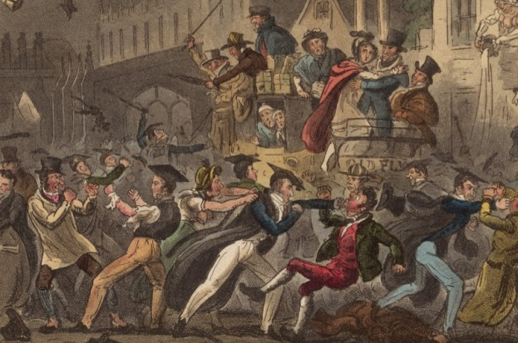
POST-WAR 1812 AMERICA: THE ERA OF GOOD FEELINGS?
Everything’s A Matter of Perspective I Suppose

Slide 2
THE FEDERALISTS: GONE . . . BUT FORGOTTEN? Nah . . .
After 1816, Jeffersonian Democratic-Republicans
ONLY party in US
Apparent lack of factionalism guiding aspect of The Era Of Good Feelings
Not the ONLY aspect
II. RIP Federalist Party: Victim of nationalism
Party gone, but FACTION remains
Demise of Feds will expand scope of Dems-Reps and subsequently further factionalize them
Already factionalized by John Randolph’s Quid Tertium
III. RESULT?
Era will last as long as factionalism will allow
Will end with Election of 1824

Slide 3
Conservative: (Marshall, JQ Adams, Henry Clay sometimes)
Hamiltonian; erstwhile Federalists
Support Clay’s American System
Loose Interpretation
Moderate: (Henry Clay, James Madison, James Monroe
Policy of necessity
Oppose BUS; American System on principle, not practice
Open to compromise
Liberals: (James Monroe, Quids, Andrew Jackson)
Pure Jeffersonian; oppose BUS and American System
States’ rights
“Common Man” specific
Strict Interpretation

Slide 4
Henry Clay’s American System
Federal Support for internal improvements (for market growth)
Protective tariff
BUS (recharter every 20 years)
Federal subsidies for business/industry
Sectional Nature
North/Midwest will embrace
South will oppose
Issue is constitutionality

Slide 5
The America 2.0 of the Era of Good Feelings
The Politics of Necessity: Hamilton’s Financial Plan becomes Henry Clay’s American System (Plan)
James Monroe and the BUS recharter (1816)
1st Protective Tariff (1816)
Internal Improvements: National Road Begun (1811)
Out of the Blue . . . PANIC!!!!
Panic of 1819
Unsteady post-war economy
Land Speculation, paper money.
Global economic downturn, increase in foreign agricultture
Failure of the Wildcats
Failure of BUS to support wildcats
RESULT: BUS becomes deeper socio-economic sectional issue

Slide 6
The Marshall Court
Conservative; decisions strengthen the power of the Federal government at the expense of states’ rights
McCullough v Maryland (1819)
“The power to tax is the power to destroy”
Worcester v Georgia (1832)
“States cannot evict sovereign Indian nations”
Gibbons v Ogden (1824)
“Regulation of Interstate commerce is a federal
matter.”

Slide 7
THE NEW DYNAMIC OF AMERICAN EXCEPTIONALISM: WESTERN MIGRATION
Westward migration: Birth of the New American
Yeoman specific
Motivation for Migration
LAND!!
Treaty Of Greenville
Land Ordinance 1785
Internal Improvements
National Road
Turnpikes
Canals
Economic Opportunity
Cotton Gin 1793
Development/Growth Northern Manufacturing
Midwest, Ohio/Tennessee River Valley Farmland
“Black belt” (Deep South) alluvial bottom land

Slide 9
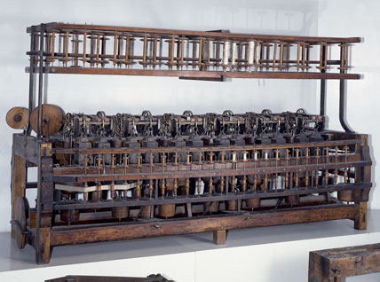
Samuel Slater’s spinning machine

Slide 10
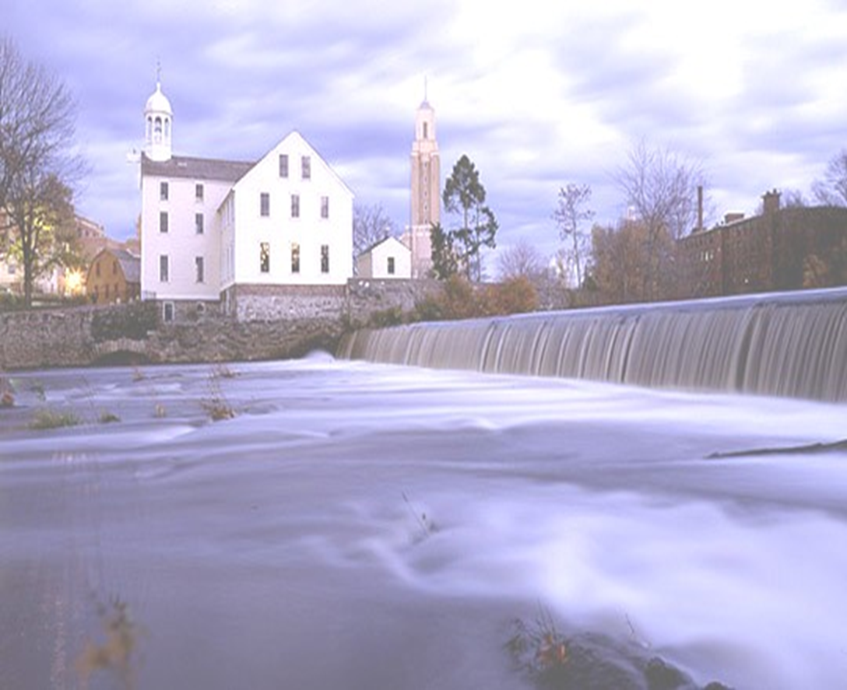
In 1793 Samuel Slater opened the first American textile mill in Pawtucket, Rhode Island. This mill, coupled with the cotton gin, laid the basis for America’s first manufacturing industry.

Slide 11
In 1810, partially in response to the crippling Embargo of 1807, Francis Cabot Lowell built the first textile “company town,” (Lowell, Massachusetts) which served to house and provide necessities for its employees.
To save labor costs he hired young, single farm girls from neighboring farms, who jumped at the chance to escape the drudgery of farm life.
They would become known as the Lowell Girls. They turned the Lowell mill town into a social experiment for change.

Slide 12
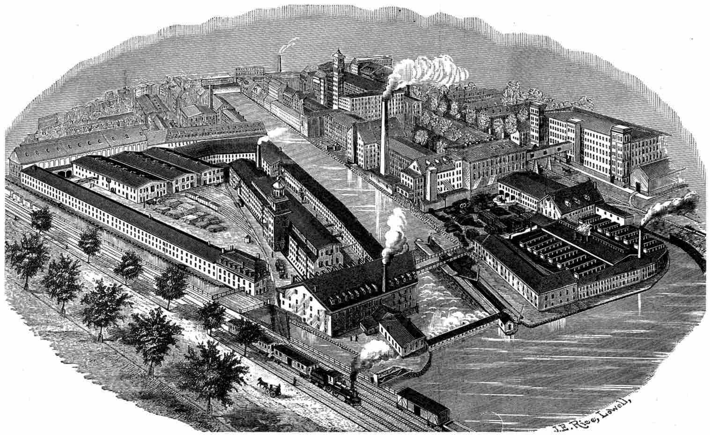
The Lowell Mill Town

Slide 13
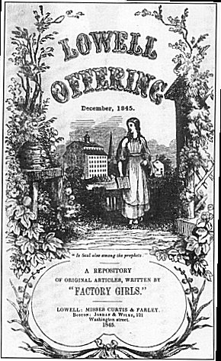
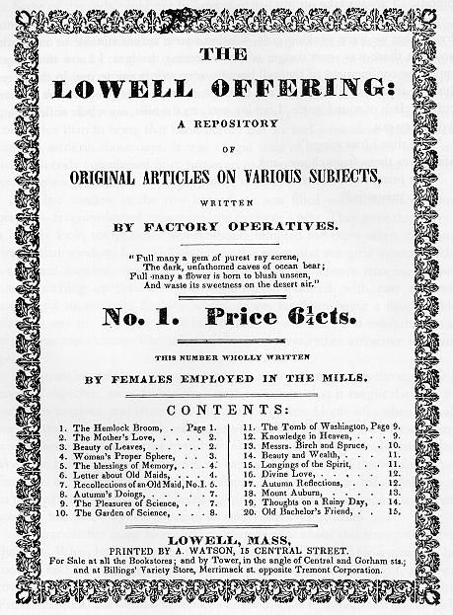
“The Lowell Offering”

Slide 14
Immigration Trends 1830-1860
Irish (economic)
German (political)
Effects:
Cheaper labor will displace Lowell Girls, a dynamic not lost on Irish immigrant workers
Northern manufacturers looking for immigrant labor b/c its cheap and plentiful
Northern state governments encouraging immigration to combat 3/5 Compromise
Immigration (esp. Irish Catholics) will call into question the purity of American culture; will result in rise of Nativism

Slide 15
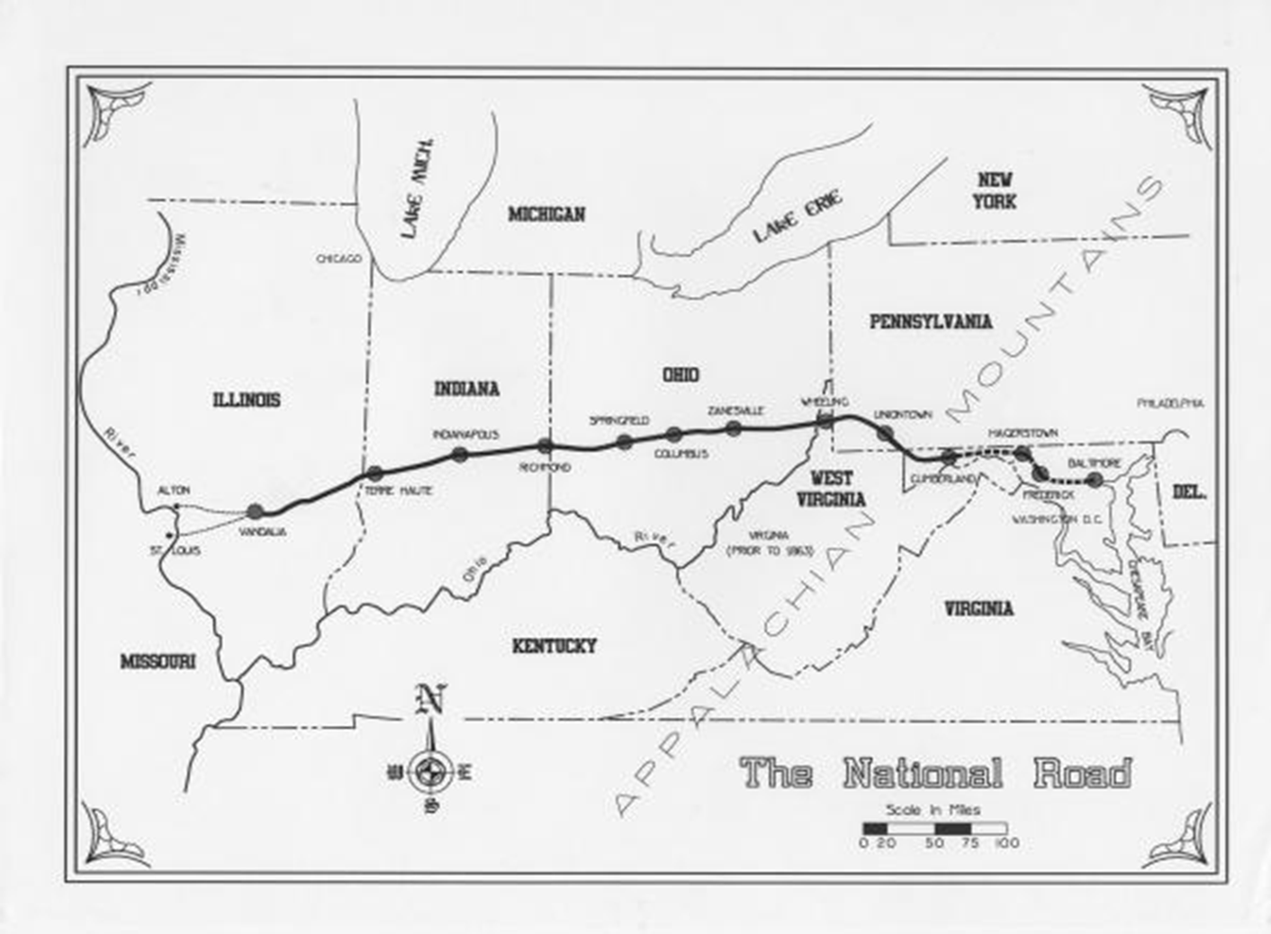
The First Internal Improvement: The National Road

Slide 16
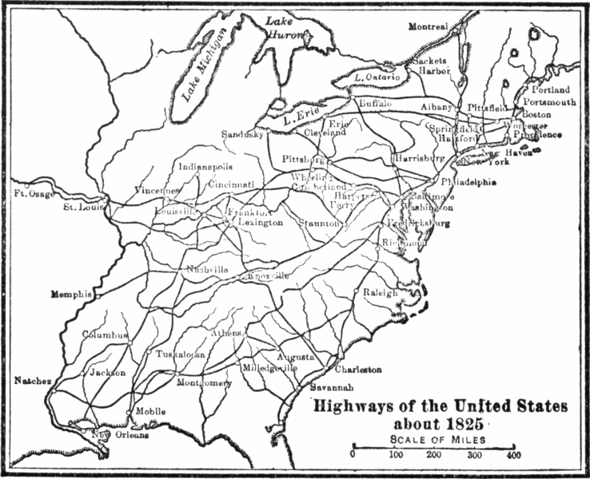
Internal Transportation Networks: Inherent Result of Trans-Appalachian Migration and the Market Revolution

Slide 17
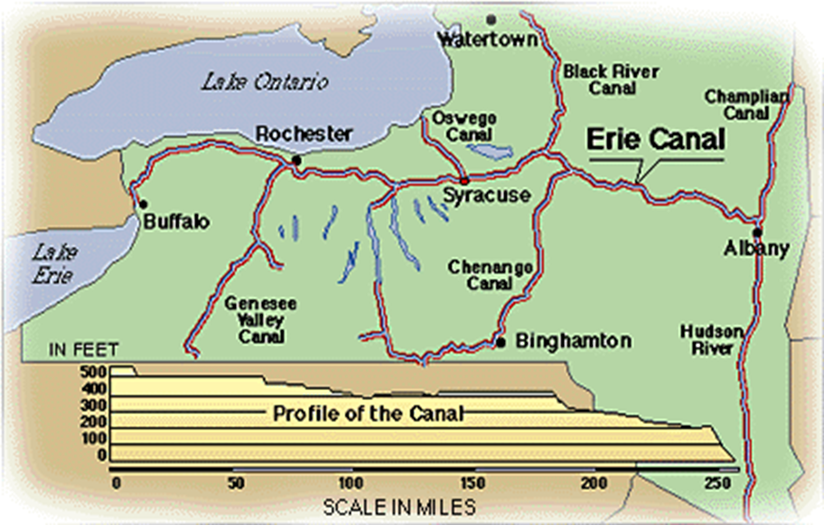
Connecting the Trans-Appalachian Frontier Producers with Eastern Markets: The Erie Canal

Slide 18
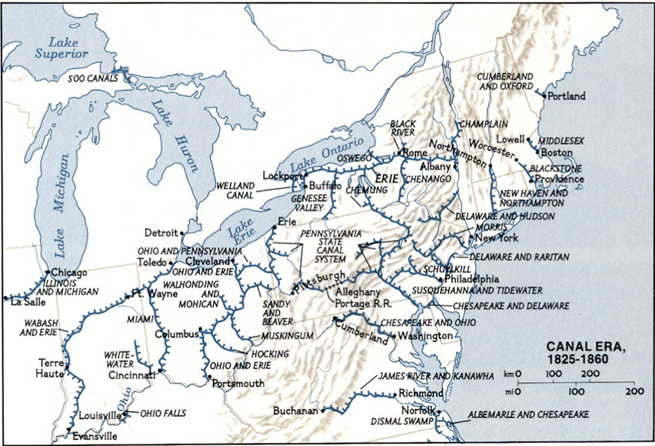
Canals: Another Example of Transportation Network as result of the Trans-Appalachian Market Economy

Slide 19
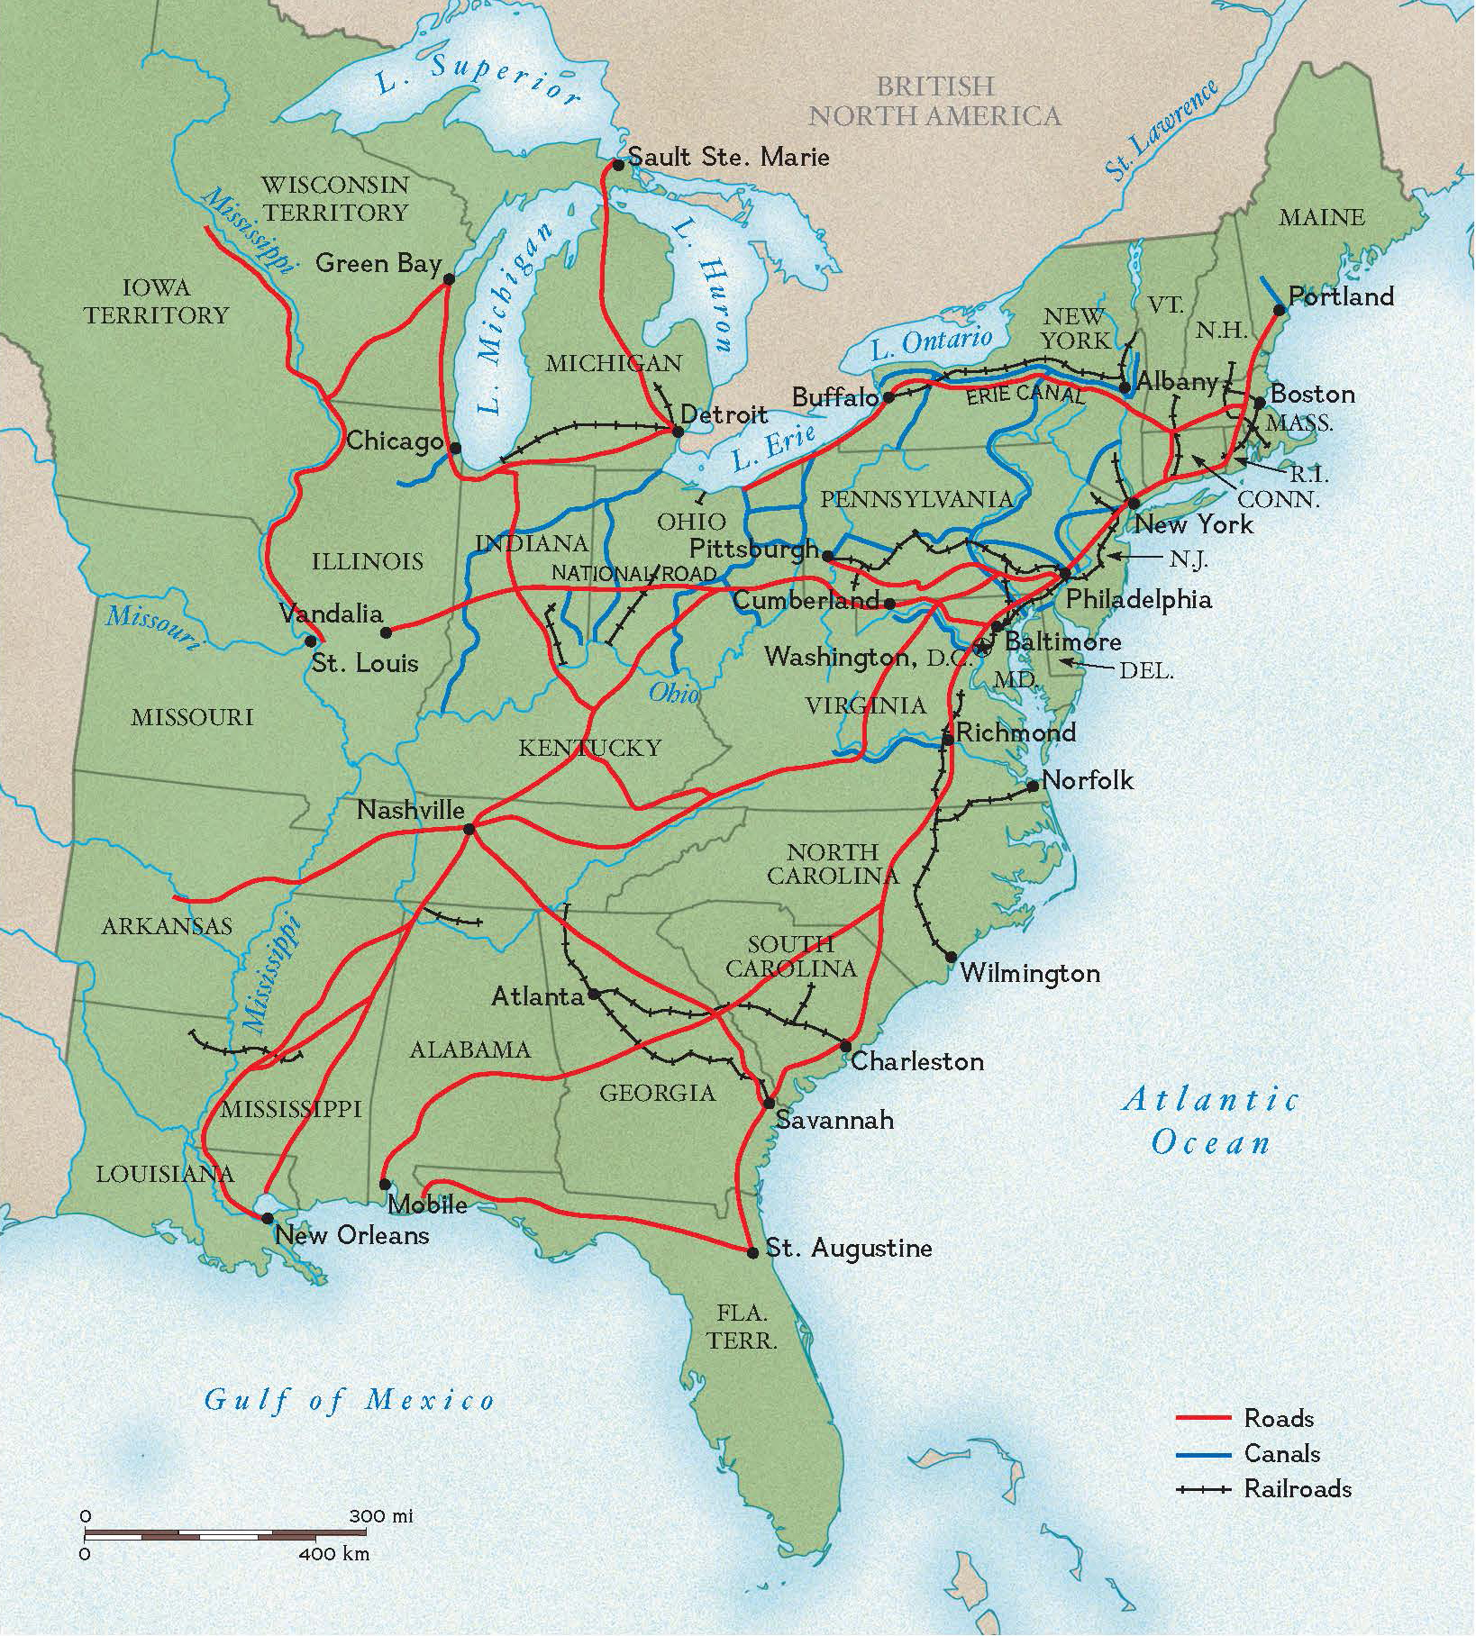
Road/Canal/Railroad Network 1840

Slide 20
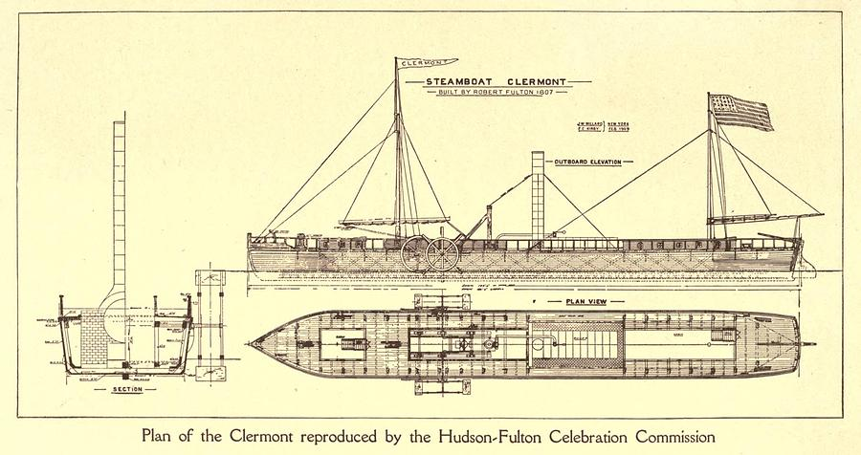
Conquering the Current: Robert Fulton and Two-Way Traffic on the Mississippi

Slide 21
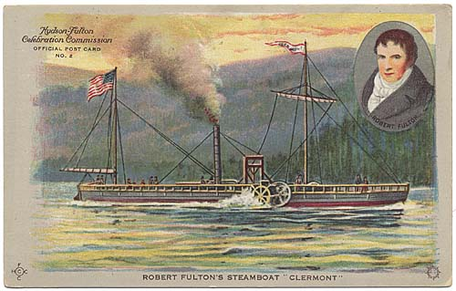
A Source of American Pride: Fulton and his Clermont

Slide 22
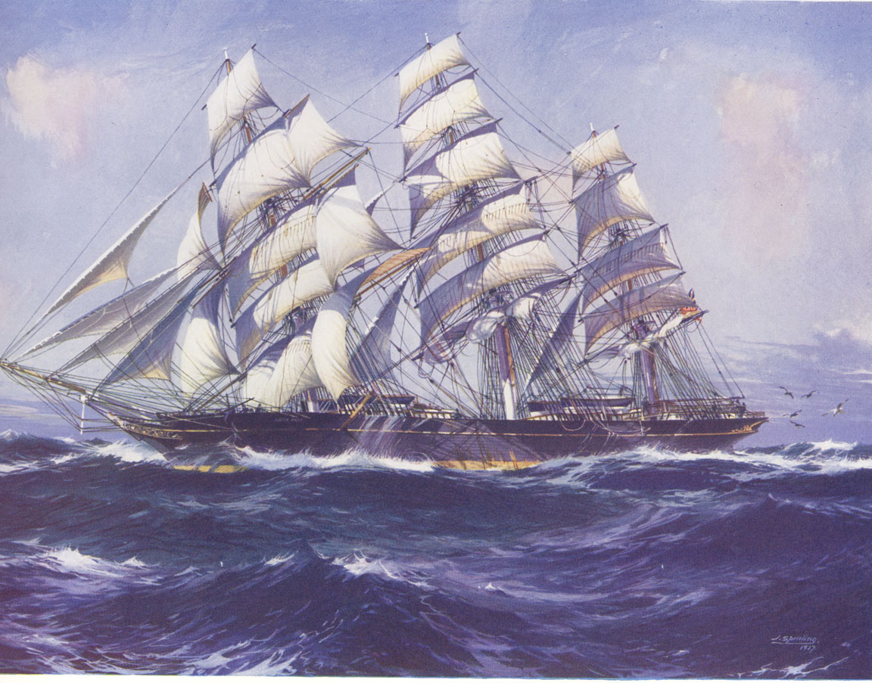
Extending Trade: East Coast to West Coast; to Asia:
The Age of the Clipper Ships

Slide 23
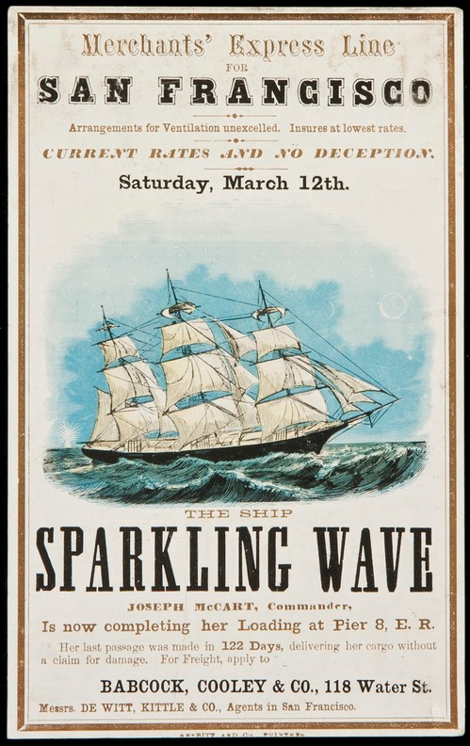
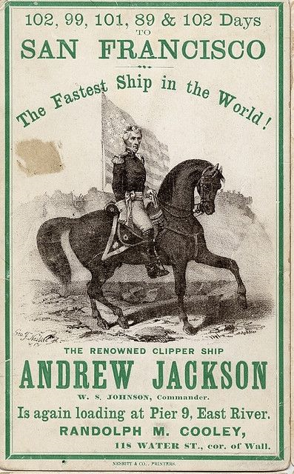

Slide 24
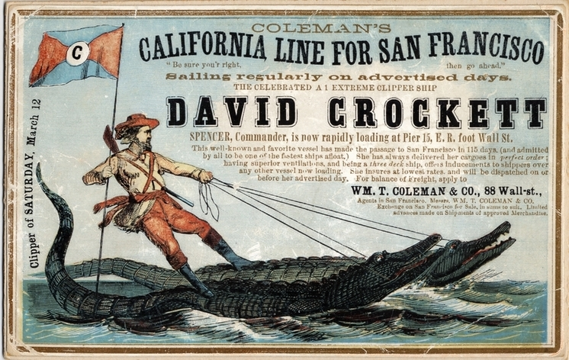

Slide 25
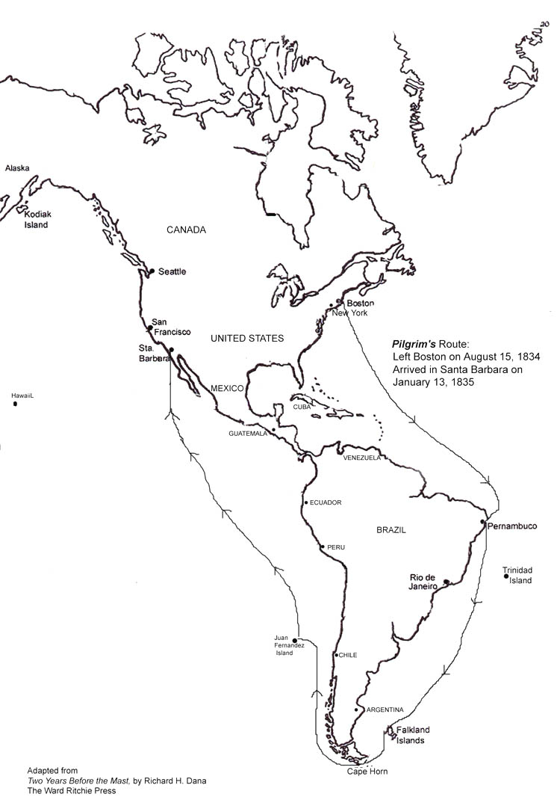
EXTREMLEY hazardous: In the trench between South America and Antarctica lie some of the roughest seas on Earth.

Slide 26
Wooden sailing vessels were no match for the “Roaring Forties.” This will necessitate a more cost-efficient passage, namely a trans-isthmus canal across Central America.

Slide 27
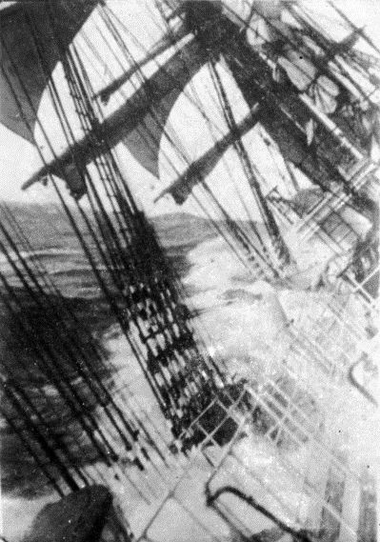
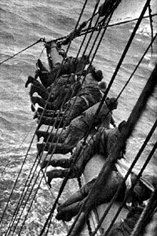
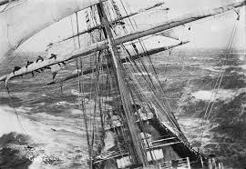

Slide 28
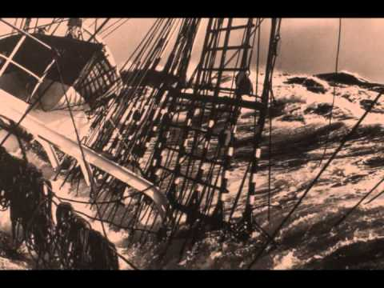
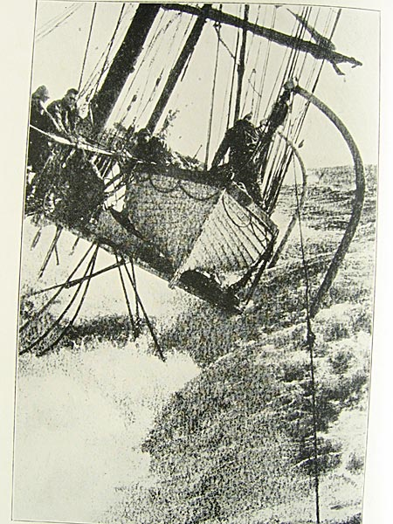
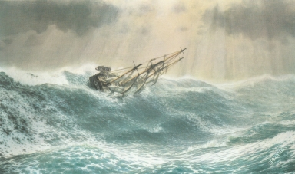
The danger and loss of capital guaranteed that the Age of the Clipper Ship would not last long.

Slide 29
Cape Horn and the Roaring Forties remain no fun.

Slide 30
Securing the Borders: American Expansion in the Early Republic:

Slide 31
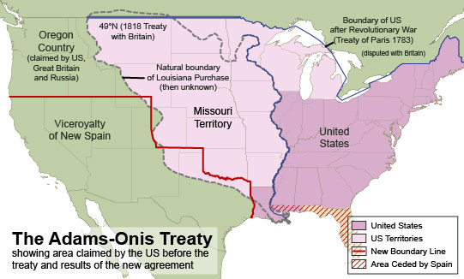
The Adams-Onis (Transcontinental) Treaty

Slide 32
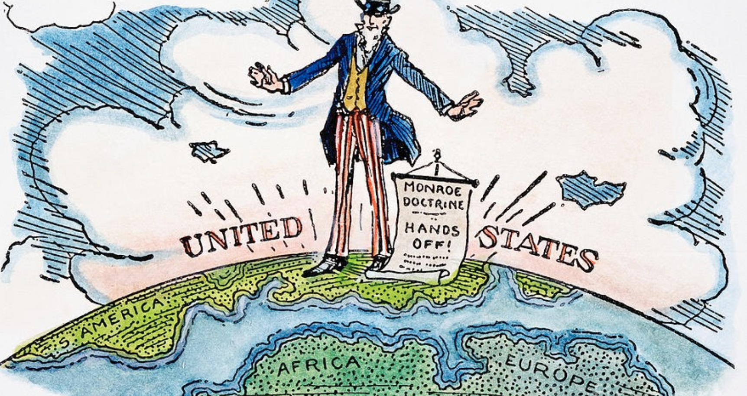
Hemispheric Solidarity: The Monroe Doctrine

Slide 33
Monroe Doctrine
Western Hemisphere off limits to European colonization
European and American political systems inherently different
Any attempt to colonize an American country will be regarded as an act of war by US
US will stay out of European issues

Slide 34
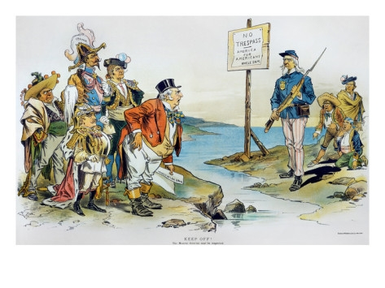
Doctrine was in part a response to the Latin American revolutions of the 1820s.

Slide 35
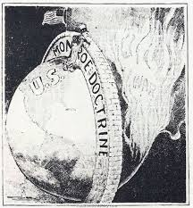
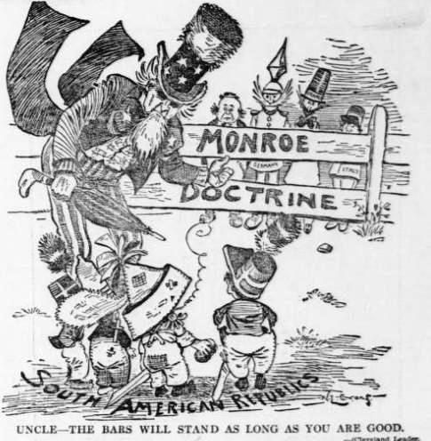
Motivation for the Monroe Doctrine?
Isolation from Europe’s monarchal tendency for violence
Protect independence of Latin American countries

Slide 36
The “Fire bell in The Night”
Slavery Extends Into the Louisiana Purchase

Slide 37
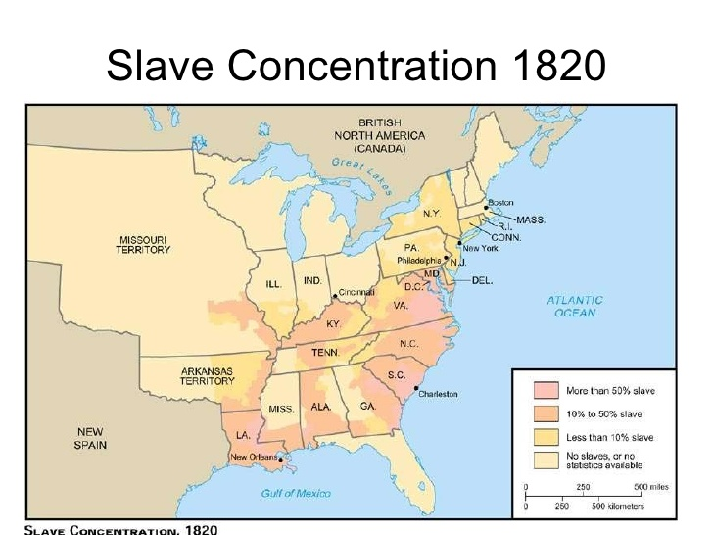
Slave Population Density, 1820

Slide 38
The Tallmadge Amendment
Supported admission of Missouri to the Union as a free state
Set an immediate ban on importation of slaves
Children born into slavery in Missouri after admission would be free at age 25
Southern Complaints:
Unconstitutional due to placing restrictions on further states based on private property
Only through the determination of the people of Missouri (popular sovereignty) that such restrictions could be placed

Slide 39
Henry Clay and The Missouri Compromise
Missouri allowed in as a slave state
Maine comes in free (to preserve Senate balance)
Established “slave border” at 36° 30´ above which slavery would not be allowed
NOTE:
The primary goal: Balance in the Senate (11 slave, 11 free)
Compromise intended for the lands of the Louisiana Purchase . . . nothing else.
What happens if . . . . ?

Slide 40
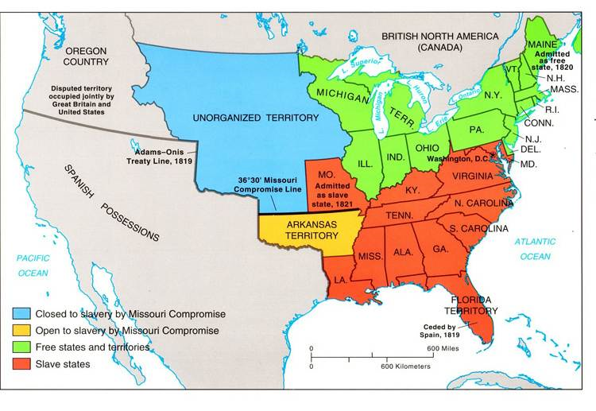
The Precedent: Missouri Compromise
Notice the 36º30´ Line and ask yourself . . .
WHY?

Slide 41
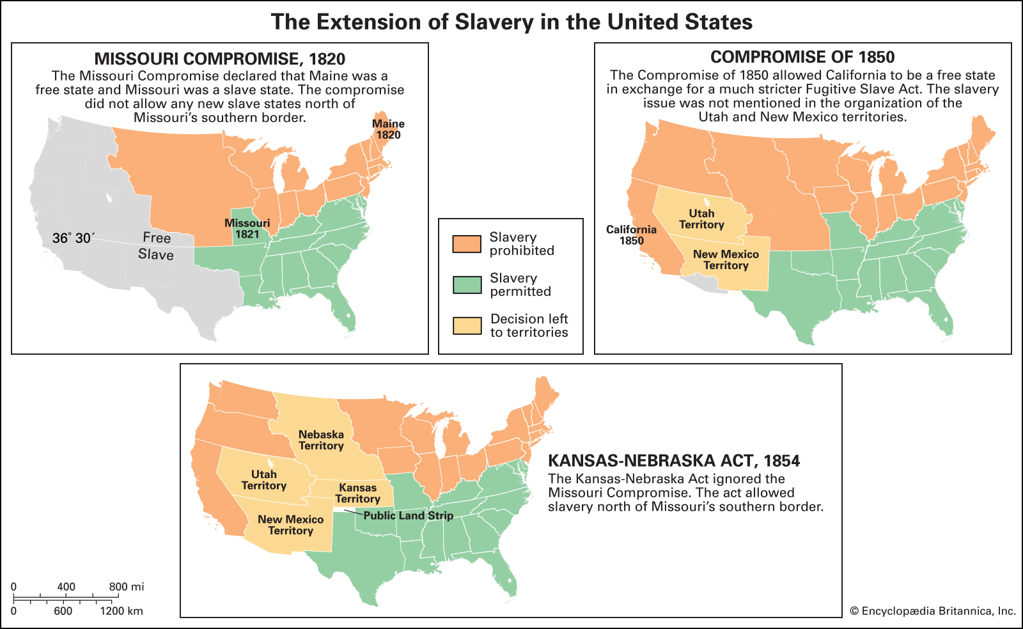
Missouri Set the Precedent

Slide 42
Social Dilemma circa 1840:
Women and Expansion
How can the Republican Mother expand their societal roles from the family to society?
In what areas can social involvement and Republican Motherhood intersect and remain true to the concept?
The catalyst: morality

Slide 43
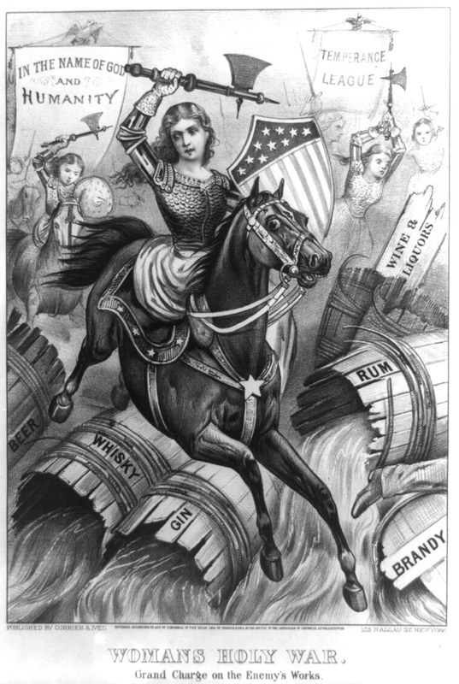
“Hell Hath No Fury”

Slide 44
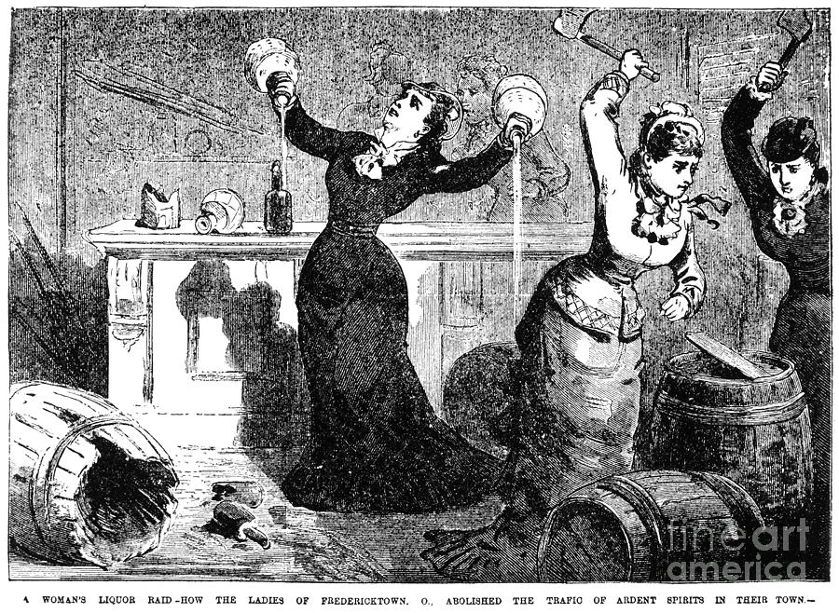
Target #1: Temperance

Slide 45
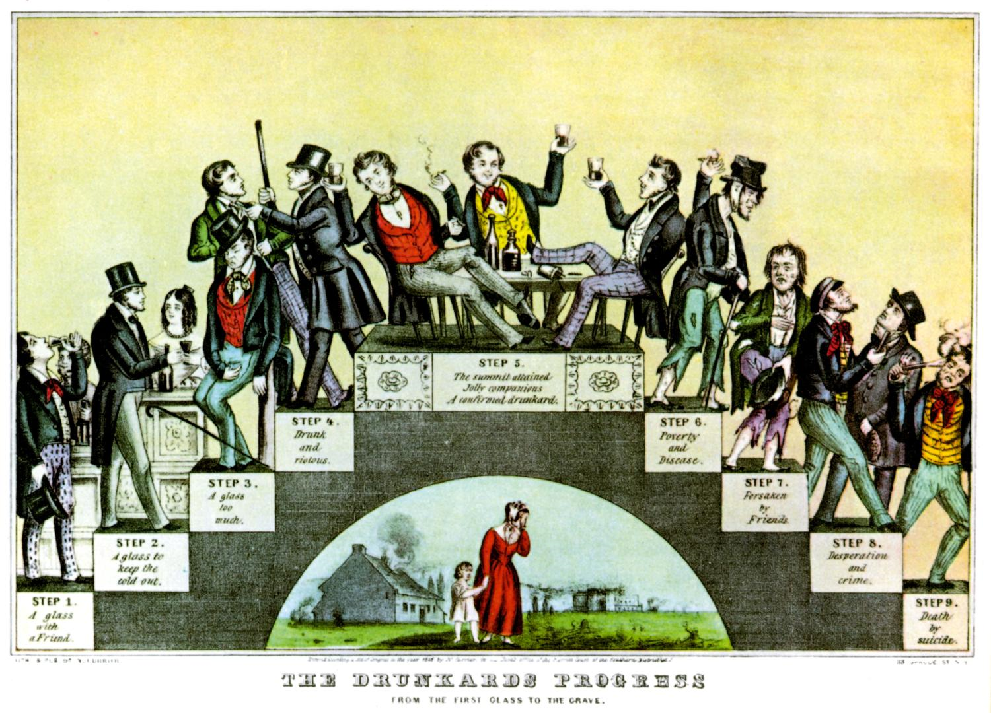

Slide 46
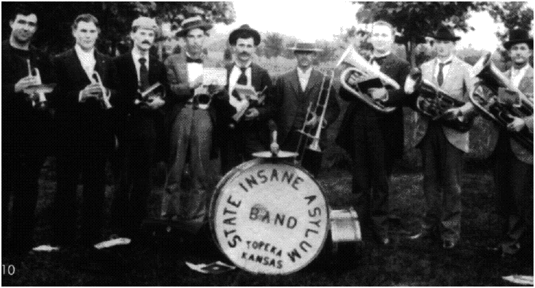
Target #2: The Insane and Mentally Deficient

Slide 47
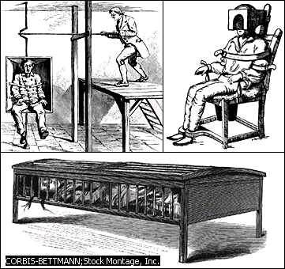
Due to the lack of psychiatric sophistication constraint and isolation were preferred methods of treatment

Slide 48
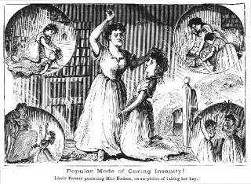
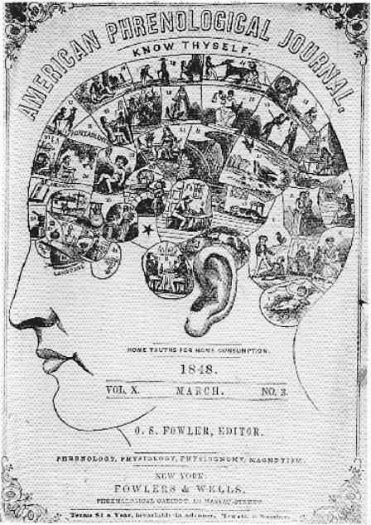
Popular methods of dealing with insanity:
“Beating some sense” into the patient
Phrenology

Slide 49
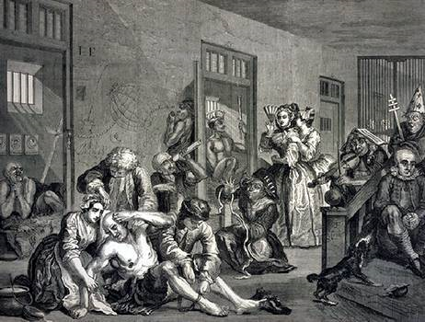
“I come as the advocate of helpless, forgotten insane men and women, of beings sunk to a condition from which the unconcerned world would retch in horror.”
Dorothea Dix

Slide 50
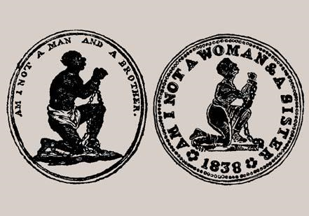
Target #3: Abolition

Slide 51
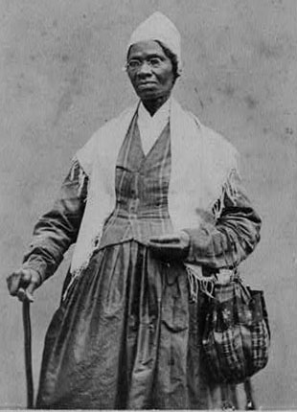
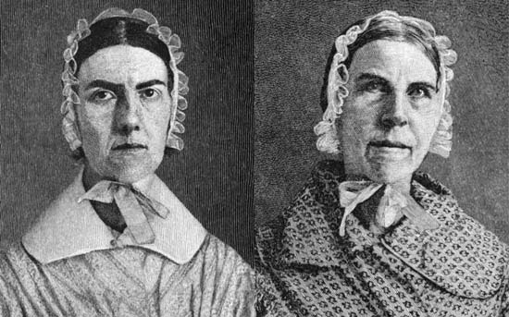
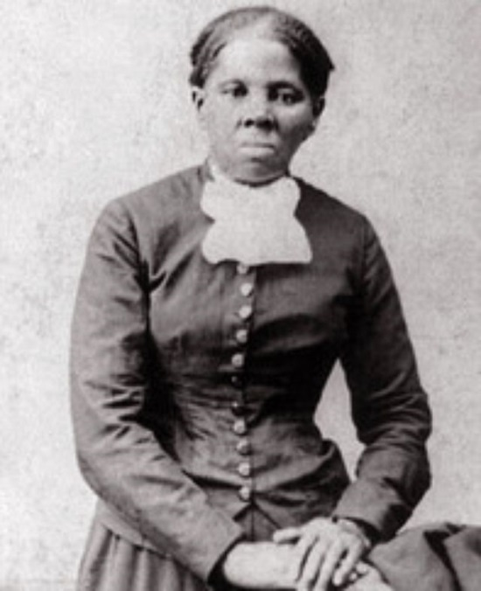
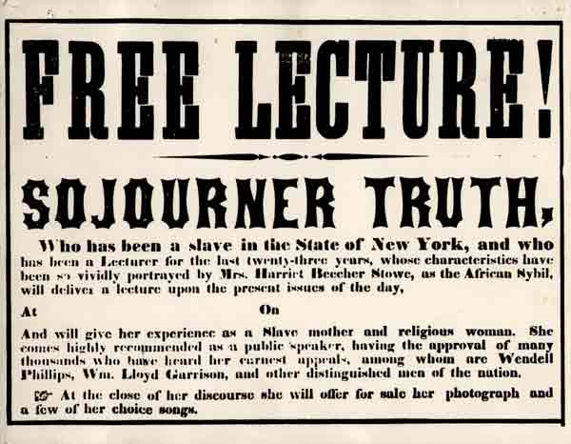
The Grimke's: Sarah and Angelique
Harriet Tubman

Slide 52
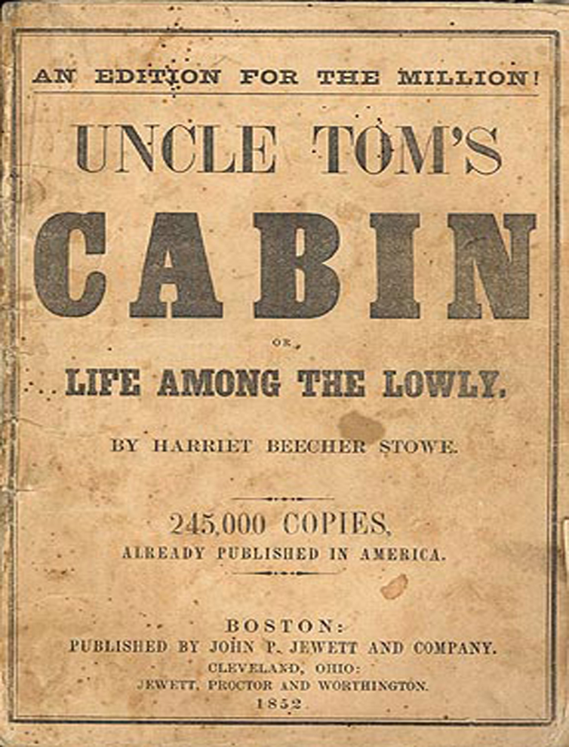
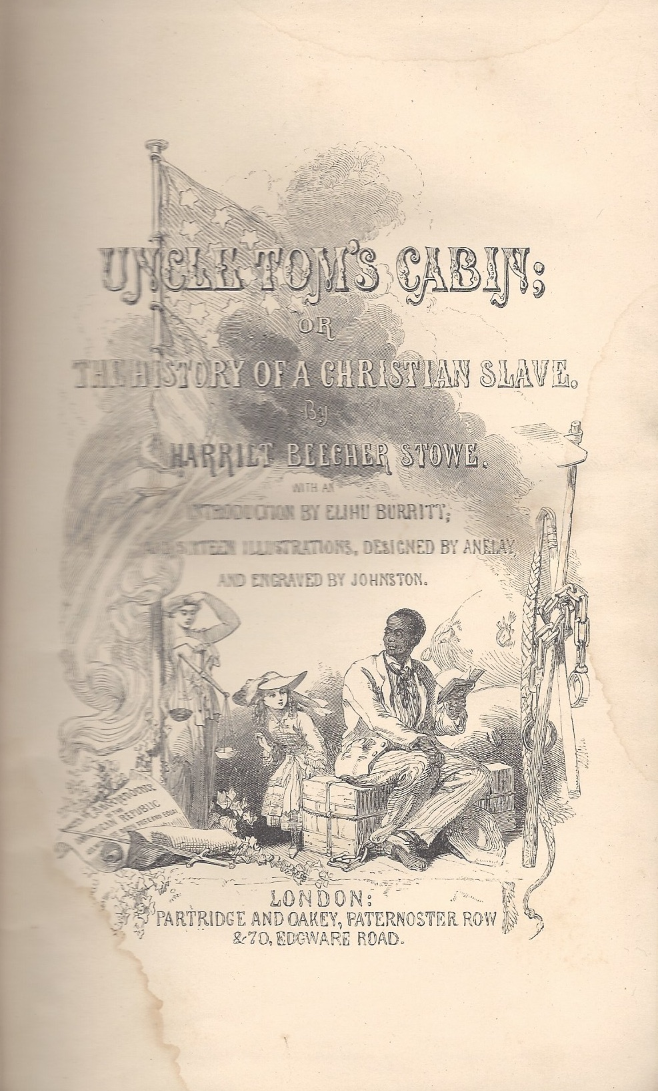
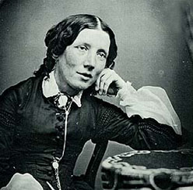
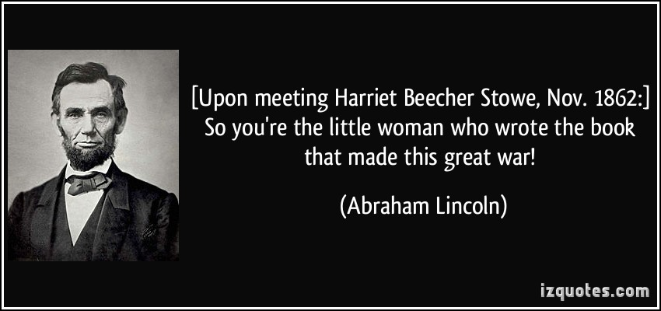

Slide 53
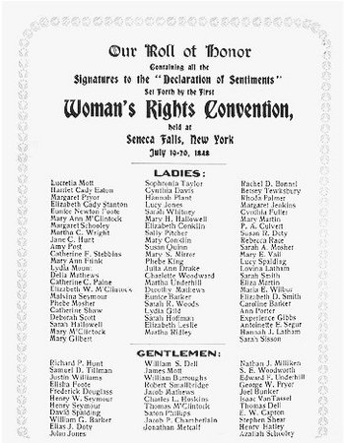
The Birth of Women’s Suffrage: Seneca Falls Convention 1848

Slide 54
Elizabeth Cady Lucretia Mott
Stanton

Slide 55
Colonization
American Colonization Society formed 1816; supporters include Jefferson, Madison, Monroe, Francis Scott Key . . . and Henry Clay.

Slide 56
Fear of inability to reconcile racial issues in the face of potential emancipation:
Future prospects for freed slaves
Resentment; race war
Competition for jobs versus immigrants
Society offered colonization as part of any emancipation/manumission policy
Clay considered colonization a de facto part of the American System
Debate over expansion relegated colonization to the back burner; will be revived by Lincoln as part of the Free Soil agenda

Slide 57
The goal of the Colonization Society was NOT the immediate emancipation and social integration of slaves, but rather the emancipation and re-settlement of Africans back to their homeland in Africa.
This assumption was based, obviously (and ultimately, erroneously, on the freed slave’s desire to relocate to Africa.
The Society realized that
(a) slaveholders would not surrender their investments
without reimbursement
(b) Africans could not be integrated into white society
and survive.

Slide 58
As a result, the Society proposed to issue a nation-wide income tax to raise funds to pay slave owners for their slaves.
Even thought the tax measure failed, Society members collected enough money to buy the freedom of a small group of Virginia slaves.
In 1821 the Society purchased land from local chieftains in West Africa and founded the colony of Liberia for the sole purpose of relocating freed slaves. In 1822 the first freed slaves arrived there and established an independent country, which still exists.

Slide 60
Two problems hindered and ultimately destroyed the Anti-Slavery Society’s goal:
First, anti-slavery and abolition groups refused to provide funds for the purchase of slaves; the lack of funds and refusal to pass an tax for that purpose doomed the Society’s efforts.
Secondly, because the deportation affected ALL Africans in America, many blacks, particularity free blacks, fought deportation to Africa, preferring the remain in the United States.
Ultimately, by 1860 only about 15,000 blacks relocated to Liberia, but the idea of emancipation and relocation persisted . . . particularly within the Whig Party and its successor party: The Republican Party

Slide 61
THE LEGACY OF COLONIZATION
“If as the friends of colonization hope, the present and coming generations of our countrymen shall succeed in freeing our land from the dangerous presence of slavery; and at the same time restore a captive people to their long-lost father-land, with bright prospects for the future; this should occur so gradually that neither races nor individuals shall have suffered by the change, it will indeed be a glorious consummation.”
Abraham Lincoln
July 6, 1852
Eulogy on Henry Clay

Slide 62
“The most pleasing solution would be to send them to Liberia, to their own native land.”
Abraham Lincoln
Speech, 1859
“I cannot make it better known than it already is that I strongly favor colonization.”
Abraham Lincoln
Message to Congress
December 1862
ART. III. Congress may appropriate money and otherwise provide for colonizing free colored persons at any place or places outside of the United States.
Proposed Amendment to the Constitution
December 1862

Slide 63
“The place I am thinking about having for a colony is in Central America. The country is a very excellent one for any people, and with great natural resources and advantages, and especially because of the similarity of climate with your native land---thus being suited to your physical condition. The particular place I have in view is to be a great highway from the Atlantic or Caribbean Sea to the Pacific Ocean, and this particular place has all the advantages for a colony.”
Lincoln to delegation of black ministers
August 1862

Slide 64
“But what shall we do with the negroes after they are free? I fear a race war . . . the solution, I feel is to be found in a program of colonization. I can hardly believe that the South and North can live in peace, unless we can get rid of the negroes. I believe it would be better to export them all to some fertile country with a good climate which they could have to themselves.”
Lincoln to Benjamin Butler
April 1865

Slide 65
Back on the frontier . . . .

Slide 66
Shakin’, Rattlin’ and Holy-Rollin’
The Second Great Awakening and The Search for Utopia

Slide 67
During the early 19th century the growing fear that secularism would accompany western expansion and result in material and political independence.
This brought about a religious revival throughout the Trans-Appalachian west known as the Second Great Awakening.
While the First Great Awakening was centered in New England and was cavalier-class centric, the Second Great Awakening was pure yeoman.

Slide 68
A Camp Meeting: Yeomen Getting’ Right With God

Slide 69
Revivals as social institutions offered a meaningful outlet to isolated people; this was especially true for women:
the revivals provided an alternative to the rigors and isolation of frontier domesticity
Revivals allowed women to stretch the constraints of the Cult of Domesticity
The revival phenomenon swept the nation in a fashion that has been described as a forest that has been devastated by fire; by 1830 the number of churches in upstate New York and western New England had grown by 1/3.
Western New York experienced such intensity that it became known as the “Burned Over District.”

Slide 70
The Burned Over District

Slide 71
The primary evangelist in the Burned Over District was Charles Grandison Finney; in one six month period in 1839 he produced over 100,000 conversions.
Finney had experienced a personal religious experience early in life when he was “overcome by the Holy Spirit and “baptized by waves of liquid love.”
Finney was an antinomian; he claimed that the only obstacle to salvation lie within the individual, therefore his revivals featured large mass conversions that took advantage of the peer and mob dynamic.

Slide 72
The Utopian Communities
The Second Great Awakening also revealed dissatisfaction among people who felt that conventional religion had failed them.
Many saw the move towards industrialization as the ruination of tradition values, and consequently sought to remove themselves from society and live purer lives . . . depending of course upon how one defines “purity.”
These efforts were collectively known as the Utopian Movement, the goal of which was to develop utopian communities.

Slide 73
Millennialism (or Millerism)
One refugee from the burned over district was William Miller, whose theology was founded on the belief that Christ would return to earth on 23 March 1843.
Thousands surrendered all of their possessions to prepare for the rapture, and at the prescribed moment, dressed in white robes, they ascended hilltops and rooftops to be nearer to their Savior.

Slide 74
When Christ did not appear, Miller set a new date of 22 October, with, of course, the same results.
This became known as the Great Disappointment.
Upon Miller’s death in 1849 the group splintered over doctrinal differences.

Slide 75
Transportation to Heaven for the well-heeled Millerite

Slide 76
For everyone else . . . hang on

Slide 77
The Oneida Community
The most radical utopian community developed in Oneida, New York.
This group was led by John Humphrey Noyes and was called Bible Communism.
Noyes most controversial belief was that of Complex Marriage, in which every man was married to every women, and vice versa

Slide 78
The movement flourished and became well known for its silver and glass ware; however growing concerns over the morality of Complex marriage, coupled with jealousies over Noyes’ marriage to ALL women, not to mention state and federal authorities, drove the leader into Canada.
After Noyes’ departure, the community adopted monogamy and became socially conventional . . . if not awkward.

Slide 79
The Shakers
The Shakers were established in 1774 by Mother Ann Lee, who claimed to be the female incarnation of God; by the late 1840s had approximately 6000 members spread over 20 communities throughout the Burned Over District and western Pennsylvania.

Slide 80
Shakers obtained their name from their physical manifestations of their conversion experience, and were originally called “Shaking Quakers.”

Slide 81
Shaker worship services were typified by gender-segregated dances.

Slide 83
HOWEVER . . .
The Shakers believed in total equality between women and men, pacifism, separation from the world and, starting in the early to mid 1800s, uh, celibacy
Massive drops in Shaker membership (gee, I wonder why?) resulted in church elders refining the basic philosophy to re-define celibacy from time to time; consequently the Shakers were able to carry on into the 21st century.
The last Shaker died in 2017

Slide 84
New Harmony
(Not to be confused with E-Harmony,
which the Shakers could have used)
British philosopher and philanthropist Robert Owen founded a utopian community at New Harmony, Indiana, in 1825.
Owen was one of the first proponents of absolute social equality, an early incarnation of social communism.

Slide 85
However, Owens's dream became unraveled due to the lack of authoritarian leadership and the subsequent slide into anarchy, and by 1827 Owen withdrew his support and the community collapsed.

Slide 86
Brook Farm
George Ripley founded his utopian community at Brook Farm, Massachusetts, in 1841. It was a working farm which emphasized the equality of labor and property for the collective good (otherwise known as social communism)
Brook Farm was founded as a joint stock company for outside investors, who would receive a portion of the farm’s profits in exchange for their support. The inhabitants received no financial incentive for their labor.
A fire destroyed the enterprise in 1845; because Ripley could not pay off the 5% interest guaranteed to his investors, the community collapsed.
The irony? Communism destroyed by capitalism

Slide 87
The Transcendentalists
Offshoot of New Light Puritans in eastern Massachusetts
Was a philosophical, religious, and literary movement (a version of Romanticism)
Basic philosophy was a rejection of conventional society, which had been corrupted by industrialization, political parties, and organized religions.
They sought to create an environment in which they could “transcend” the corruptive nature of industrial society
Religion was a means to an end, not the end itself

Slide 88
Transcendentalism called for
A life of simplicity free of materialism
Inner reflection and discipline
Emphasis a direct relationship with God and nature; believed that nature was the physical manifestation of God on Earth:
“The indescribable innocence and benevolence of Nature, of sun and wind and rain, of summer and winter; such health, such cheer, they afford forever! Shall I not have intelligence with the earth? Am I not partly leaves and vegetable mold myself? That great nature in which we rest, is contained and made one with all others. We live in succession, in division, in parts, in particles. Within man is the soul of the whole; the wise silence; the universal beauty, to which every part and particle is equally related into the eternal ONE.”
Henry David Thoreau, 1845
Walden

Slide 89
“The government is a machine that may or may not do enough good to counterbalance what evil it commits, in which case citizens must [be prepared] to retrieve that which is theirs, through rebellion if necessary. Opponents of reform are not faraway politicians but ordinary people who cooperate with the system. The expression of opposition to slavery is meaningless, only action will demand redress.
Wrong will be redressed only by the individual, not through the mechanism of government. Man has other, higher duties than eradicating institutional wrong, still he must at least not be guilty through compliance. The individual must not support the structure of government, must act with principle, must break the law if necessary.
The present conflict (The Mexican War) is unjust, peace can only be achieved by withdrawing support from the government, which in [my] current situation can be accomplished practically through the nonpayment of taxes. If imprisonment is the result, there is no shame in it; indeed prison is the best place for a just man in an unjust society. In the current state of affairs, forcible payment of taxes is violent and bloody; refusal to comply constitutes a peaceable revolution.
Civil Disobedience, 1848
Henry David Thoreau

Slide 90
The High Priests of Transcendentalism:
Ralph Waldo Emerson Henry David Thoreau

Slide 91
The Mormons
One result of the “burned over district” was the conversion experience of Joseph Smith.
Smith experienced visions which revealed to him a new interpretation of the gospels, prompting him and his followers leave the Burnt Over District, and, after initial difficulties founded their own settlement in Nauvoo, Illinois, where they became known as the Church of Jesus Christ of Latter Day Saints, or the Mormons.
They are the most successful of the utopian experiments, primarily due to their isolation

Slide 92
Over a period of time Smith fell out of favor with local officials, and was soon arrested on what many considered politically-influenced charges.
Smith’s imprisonment set off a wave of protests; in June 1844 Smith and his brother were killed while in Illinois.
Smith’s primary lieutenant, Brigham Young, took over for Smith, and in 1847 led the Mormons on an exodus from Nauvoo into the far reaches of the Mexican territory, founding a community near the Great Salt Lake Basin in what he called Deseret (later Utah).
Upon the admittance of Utah as a territory Mormons resisted attempts by federal officials to settle the area, and armed conflict (The Utah War) erupted in 1857. Soon, however, a truce was worked out, and despite numerous schisms inherent with any church the Church of Latter Day Saints still flourishes today.

Slide 93
ABOLITION TURNS RADICAL
William Lloyd Henry Ward John
Garrison Beecher Brown

Slide 94
David Walker was born a free black in North Carolina and moved to Massachusetts.
Walker published Walker’s Appeal to the Colored Citizens of the World, which advocated violence as the only response to the oppression of enslaved Africans.
Southern officials demanded Walker’s arrest on charges of attempts to incite insurrection; however state officials refused extradition on the grounds that he had broken no laws in Massachusetts.

Slide 95
William Lloyd Garrison and
The Liberator
Garrison’s newspaper circulated through both North and South. As he became more despised in the South, Garrison completely abandoned moderation, stating that ”I will be harsh as truth and as uncompromising as justice. On this subject (abolition) I do not wish to think, speak, or write with moderation . . . And I WILL BE HEARD.”

Slide 96
Southern outrage actually advertised The Liberator more than its actual readers; slaves were exposed to Garrison’s ideas not through the actual paper but through the protests of their masters.
Six Southern states indicted Garrison for instigating the Nat Turner Rebellion, as well as attempting to instigate other servile revolts, and demanded that Massachusetts extradite him and Walker South for trial.
Massachusetts’ refusal only exacerbated Southern outrage and verified fears of a northern anti-slave conspiracy.
By 1851, this North-South rhetoric, exacerbated by the Texas annexation controversy, reached the halls of Congress

Slide 97
In 1851, the Speaker of the House introduced a bill calling for abolition in the nation’s capital.
Southern Congressmen, however, introduced counter- legislation which demanded that, due to the destructive and divisive nature of the issue, any bill involving abolition be tabled.
This was the notorious “gag rule,” which, anti-slavery congressmen charged, violated the First Amendment.

Slide 98
The “Great American Sin” (John Brown 1855)

Slide 106
THE SCIENCE OF CULTURAL SCHIZOPHRENIA
White and Slave Society The Antebellum South

Slide 107
I. Southern White Culture
1. Demographics of the Slaveholding South
White society in the South was not a paradise of solidarity; in fact, the large planter class was by far the minority and exception to the rule.
The following statistics are based on the 1860 census which listed the Southern white population at around eight million, of which only 383,000 (or roughly 5 %) owned any slaves at all.
However, in a reflection of the peripheral business effects of slavery, the number of whites with at least a proprietary interest in slaves numbered 1.9 million

Slide 108
If a planter is defined as owning at least twenty slaves:
Only one in thirty southern whites were classified as planters
Fewer than 11,000 of these planters owned fifty or more slaves
Only 2,292 planters owned at least one hundred slaves
Eleven planters owned five hundred slaves
Only one planter owned as many as one thousand slaves

Slide 109
All in all, the planter group made up roughly 4% of the adult white male population of the South, and owned more than half the slaves
While the overwhelming majority of southern white males belonged to the small-farmer class, the minority planter class considered themselves the living legacies of the Jeffersonian landed aristocracy, with whom the right to rule and govern existed.
Due to the small farmer’s desire to one day become planters, this assumption was rarely challenged, resulting in a planter-class oligarchy in the South.

Slide 110
II. Southern African Culture
Slavery had grown exponentially with its profitability
By 1860, a slave owner was able to recoup a 10% return on his investment, making slavery profitable both in practicality as well as an investment.
There were less than 700,000 slaves in the United States in 1790; by 1830 this number had grown to more than two million, and by 1860 to more than four million.

Slide 111
Not all Africans were slaves; throughout the United States “free persons of color” occupied a strange social status located somewhere slavery and freedom by virtue of racial injustice.
By 1830 over 319,000 free blacks lived in the United States, of which 150,000 lived in the South; by 1860 this number grew to 262,000 (see Henry Louis Gates’ statistics in the Civil War PowerPoint)
Among the southern free blacks were persons of mixed race, or mulattos.
In some areas of the urban south, especially New Orleans, mulattos constituted a distinctive third caste, many of whom were slaveholders themselves . . . In 1852 a Louisiana mulatto purchased a eight thousand acre sugar and rice plantation, estate, and 135 slaves for $250,000.00

Slide 112
An example of the paradox of the free person of color, consider the case of South Carolina cotton gin maker William Ellison.
Ellison purchased his freedom from his master in 1816, and by 1860 had become the wealthiest free black in South Carolina.
Ellison owned his gin making factory, several businesses, and an 800-acre plantation with sixty slaves.
During the Civil War Ellison supported and, in 1865, fought for the Confederacy.

Slide 113
However, Ellison’s case was extremely rare for obvious reasons.
The 1850 census showed that only 3,775 free blacks owned 12,760 slaves.
In a reflection of the economic aspect of African slavery the vast majority of these were located in New Jersey, Connecticut, Illinois, Rhode Island, and New York; as opposed to the racial-social duality of slavery evident in the South, where less than 2% of free black slave owners resided
All free blacks, regardless of location, were subject to discrimination; all southern free blacks were required to carry ID badges lest they be caught and sold into slavery.
You didn’t have to remind these folks to wear their ID.

Slide 114
In northern states, free blacks suffered worse treatment due to the threat of their labor; discrimination by virtue of economic threat.
Indiana introduced a statute in 1856 that banned any blacks from entering the state; Ohio began a slow repatriation of their free black population to other states in 1853.
In comparison, both North and South incorporated racism and economics in their treatment of Africans; the South needed African free labor; the North feared economic catastrophe of mass white unemployment brought about by the competition of cheap black labor.
No matter how you look at it, regardless of where one might reside, being black in the antebellum United States was absolute misery, with little or no way out.

Slide 115
The Slave Trade
From 1790 until 1860 the number of slaves had grown from 698,000 to over 4 million, even though the international slave trade had been abolished in 1808 by the constitution’s Slave Trade Compromise
The primary method of this increase was through natural increase, which resulted in the growth of the domestic slave trade.
A slave’s worth was directly tied to his/her commodity; due to the increasing value of cotton, the value of a healthy male slave in his 20s increased from $400.00 in 1790 to over $2000.00 in 1860. Slaves with special skill (carpenters etc) were worth even more.

Slide 116
The slave trade was the most odious of the entire “peculiar institution,” and resulted in towns of any size having slave brokerage farms, slave holding pens, auctioneers, and slave breeding brokers.
The worst aspect of the slave trade was the breakup of families.
Although many planters tried to keep families together for morale purposes, the necessities of economy outweighed sentimentalism and forced the tragic breakups

Slide 120
Plantation Slavery
The vast majority of slaves in the South worked in the fields, although skilled slaves such as carpenters, furniture makers and domestics (for female slaves) worked in and around the home.
Field hands typically lived in one and two-room houses, most with dirt floors, many without windows.
Plantation records show that these conditions were devastating to slave infants born in the field hand quarters; more than half died within the first year of life

Slide 121
Most field hands worked from dawn to dusk, from “kin to kaint.” (From “can” to “can’t”)
Local slave codes were designed to keep restive slaves under control while providing guidance for slave drivers and overseers.
Disobedience resulted in on-sight reprimand, both punitive and representative in nature.
The tool of choice was the lash, which was authorized by slave codes; more harmful methods, such as brickbats or guns, were outlawed except in case of slave violence.
Typically, a good owner was one that did not “whip too much;” a bad one “whipped you until he bloodied you blistered you.”

Slide 123
Of course, the primary recourse for slaves was flight or rebellion; both of these held horrible risks if the slave was caught.
Runaway slaves were dealt with severely, often beaten to the verge of death but they were typically allowed to live because they were primarily an investment.
Rebellious slaves, however, were summarily executed; they were seen as incorrigible and unfit to live.

Slide 124
Slaves did, however, manage to exact their resentment toward oppression through sabotage or malingering.
Slave narratives show that, contrary to conventional wisdom, a surprising number of slaveholders were smart enough to realize that a happy slave was a harder-working slave, and consequently treated their slaves relatively well, even to the point of withholding benefits rather than inflict physical punishment.
Again, the slave as an economic entity dictated their treatment; many slaveholders exhibited their healthy, happy slaves as status symbols.

Slide 125
Slave Culture
Slaves lived a life of hopelessness, and therefore sought relief and justification for their lot in life through religion.
Slave religions were a microcosm of their ethnic legacies, often mixing amounts of native animistic religions, African spiritualism, and Christianity. As such, African religion was (and is) vastly different than the white variety by virtue of its depth of spirituality, born of desperation.
In Louisiana, this mixture featured aspects of Caribbean Catholicism, which resulted in variants of Christianity such as voodoo.
Much like Second Great Awakening Baptists, African religions formed the basis of community

Slide 126
Many slaves embraced Christianity due to their perception of identification with the Israelites of the Old Testament.
Some slave owners encouraged the growth of slave religion and churches as an important aspect of healthy slave life, and used the right to worship as controlling mechanism.
Others, however, saw religion as a dangerous means of solidarity and banned religious meetings of any kind. This only served to drive the meetings underground, and resulted in severe punishment.

Slide 127
The role of women in African culture was a convoluted mixture of traditional cult of domesticity within the slave family, the assumption of that same role in their master’s household, mother to her own children and, often, concubine to their masters.
Sexual promiscuity as a result of exploitation by white masters was prevalent, as the existence of numerous mulattos attests.
The existence of such an overwhelming mulatto demographic reveals the presence of systematic rape; the census of 1860 reveals the existence of 412,000 mulattos in the United States or about 10% of the entire African population

Slide 128
The Defense of Slavery
States in the upper South, primarily those whose land had been exhausted by tobacco, took an earnest look at manumission (voluntarily freeing their slaves)in the early 19th century.
Southern attempts to deal with their own slavery ended in 1836, however, when Virginia legislature defeated a measure to gradually emancipate and repatriate slaves to Liberia
By the late 1830s, as a result of the increasing attacks, both perceived and real, on Southern culture and the peculiar institution, some southerners began a campaign to legitimize slavery on moral and intellectual grounds.
The primary arguments were two-fold.

Slide 129
The first argument was powerful because it was biblical in nature, holding that religious figures of the Old Testament had held slaves, that St. Paul had admonished his servants to obey their masters and had even instructed a runaway slave to return to his master, and pointed out that Jesus had remained silent on the issue, at least by virtue of His words as reported in the Gospels.
This controversial stand resulted in a sectional split in the Baptist Church, leading to the creation of the Southern Baptist Convention.

Slide 130
The second argument was evolutionary, paternalistic, and racist by nature, claiming the “natural” inferiority of backs to whites.
This view stated that due to their misfortune of having reared from Africa blacks were a lesser species than whites, and as such whites had the moral obligation to care for them in whichever manner benefited them best . . . which, of course, was slavery.
Those who advocated this view drew their philosophical basis from Thomas Jefferson's 1785 Notes on the State of Virginia, in which Jefferson stated that due to their evolutionary inferiority Africans could not be expected to co-exist with whites, and that slavery was their natural lot in life.

Slide 131
Southern literature of the time reflected the increasing defense of slavery.
William Grayson's 1856 poem The Hireling and the Slave contrasted the oppression of northern industrial “wage slavery” to the “benevolent” slavery of the South
George Fitzhugh’s 1854 book on “southern sociology,” Sociology of the South, or The Failure of a Free Society, as well as 1854’s Cannibals All! extolled the sociological legitimacy of slavery over the rampant and oppressive capitalism of the north; northern industrial labor practices brought far more abuse and hardship than slavery.

Slide 132
Fitzhugh declared that southern slavery was the purest form of socialism, for it provided its charges with hierarchal care in sickness and old age.
Northern workers, on the other hand, were exploited for profit and cast aside when their usefulness expired.
John C Calhoun praised slavery as releasing the Cavalier ruling class to “improve themselves in a manner that benefits all southerners.”
All in all, northern abolitionists, to whom these defenses were intended, weren’t buying it.

