Slide 1
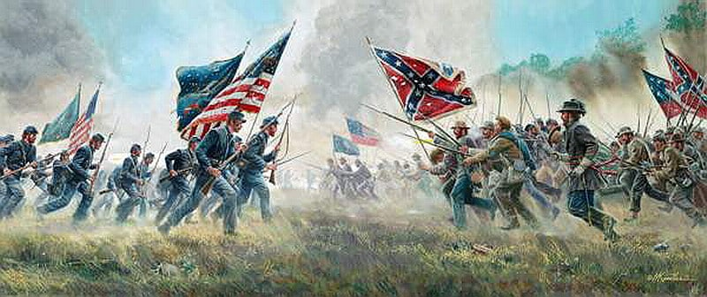
The Civil War: The Watershed of American History
The End of America 1.0
Beginning of America 2.0

Slide 2
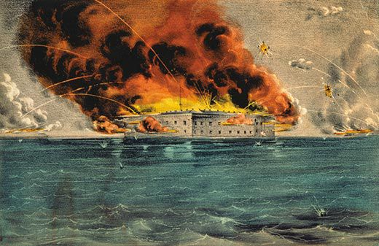
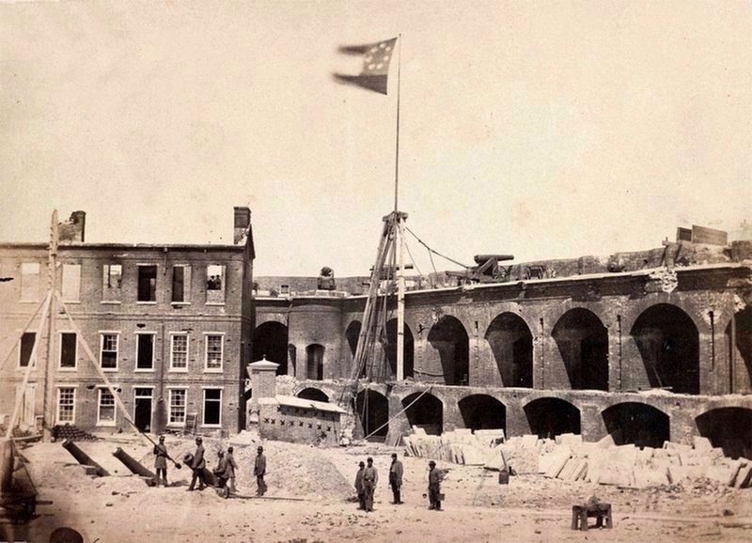
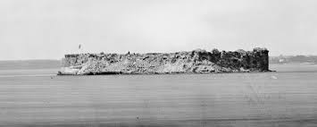
How in the World Did We Get To This?
Fort Sumter
12 April 1861

Slide 3
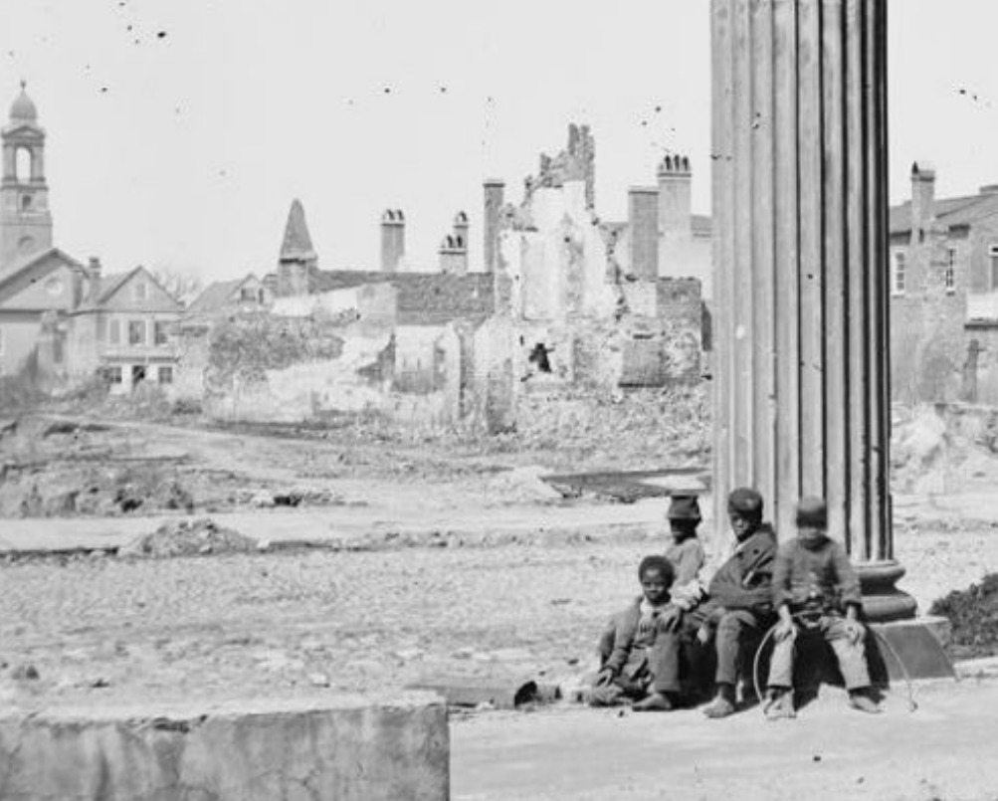
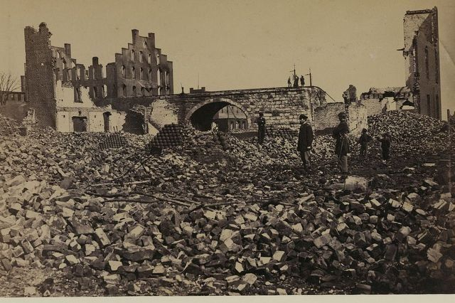
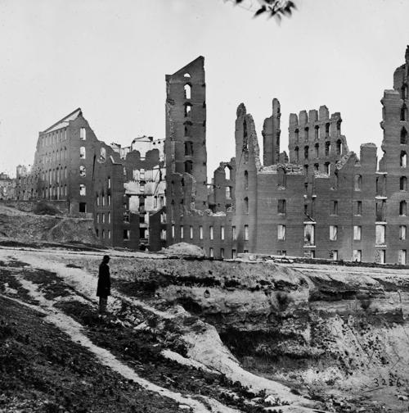
AND THIS . . . .

Slide 4
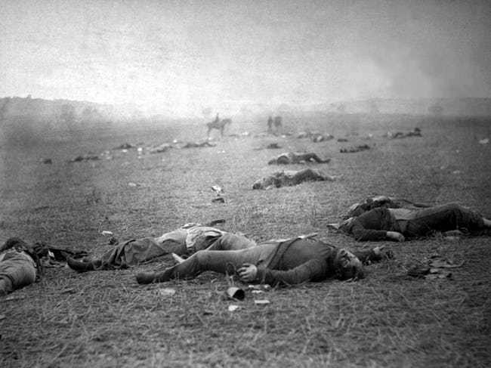
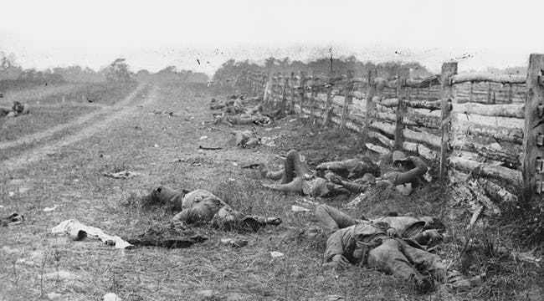
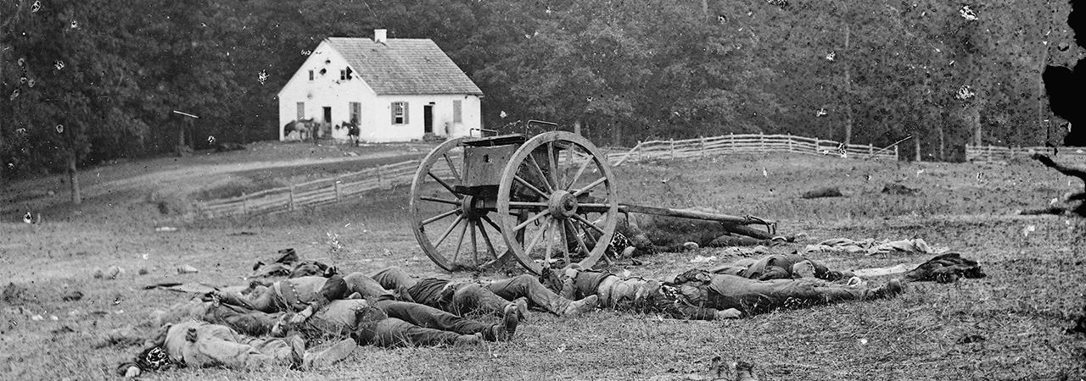
AND THIS . . .

Slide 5
SITUATION CA. ELECTION 1860. . .
The Sectionalist Economy
North: domestic market economy; industrial, progressive
Labor: Free labor, competitive
South: Export demand economy; agrarian; traditional
Labor: Slave labor, chattel
Political parallels:
North: Republican/Free Soil philosophy (incl. American System)
South: Democratic states’ rights philosophy, expansionist
Foreign Policy
North: Isolationist, government-sanctioned trade protectionism
South: Export economy policy based on state-controlled free (tariff free) trade
France/England dependent on southern cotton; matter of national security
Immigration
Northern dilemma: Extent of inclusion vs. nativism
South: No immigration

Slide 6
III. Wrestling With The Beast: The Effects of Slavery
Slavery and Expansion: What’s the solution?
Missouri Compromise:
Wilmot Proviso:
Compromise 1850:
Kansas Nebraska Act:
Points of contention:
3/5 Compromise
1850 Fugitive Slave Act
Escalation: The Point of No Return
Bleeding Kansas; John Brown and Harper’s Ferry
Dred Scott Decision
Southern Orthodox Doctrine; southern deportation laws
Election of Lincoln

Slide 7
IV. Disunion
Post-Election 1860
Lincoln’s Free Soil Pledge: limit on spread non-negotiable
American System: pre-election troubles in Democratic Congress; post-secession success
Homestead Act: Free land in trans-Mississippi West
Pacific Railway Act: Transcontinental Railroad (internal improvement)
Morrill Land Grant Act: Establish land grant research facilities in the West
Morrill Tariff 1861/62
Originally protectionist b/c Panic 1857; Increase addendum in 1862 to finance war (38%)
Eventually will fund 43% ($345 million) of war revenue demands
Lincoln’s Constitutional Dilemmas:
Secession?
Political status of the CSA? Nation-state? Belligerent? Rebellion?
Border States (Delaware, Maryland, Kentucky, Missouri):
Maryland: Martial law, suspension habeas corpus, suppression of the press . . . Violations of civil liberties? Constitutional?
Missouri, Kentucky: Precedent of Kansas (two governments; each features secession and inclusion into CSA), guerilla warfare
Mr. Lincoln Goes to War
After Sumter, Virginia, 6 more states secede
Lincoln’s call for 75,000 troops (“90 Day Wonders”)

Slide 8
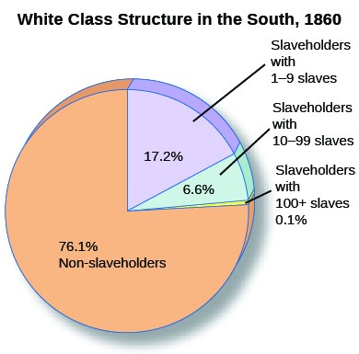
On a typical planation (20 slaves), the capital investment in slaves was greater than the combined cost of land and equipment, and was the leading reason for debt.
1. What motivated the remaining 70+%?
2. Why would this minority fight for people they despised (Planters)?
Southern nationalism
Defense of home (“B/C you’re down here”)
Belief in “Herrenvolk democracy” (legacy of white supremacy)

Slide 9
War Aims: Slavery versus Union?
“Do the people of the South really entertain fears that a Republican administration would, directly or indirectly, interfere with their slaves, or with them about their slaves? If they do, I wish to assure you, as once a friend, and still, I hope, not an enemy, there is no cause for such fears.”
Lincoln To Alexander Stephens, November 1860
Congressionally-Mandated War Aims: The Crittenden-Johnson Resolution (June 861)
“Resolved by the House of Representatives of the Congress of the United States, That the present war has been forced upon our nation by the Southern States now in revolt against the constitutional government of the United States; that in this national emergency Congress shall pursue its duty and resolve that this war will not be waged on our part in any spirit of oppression, nor for conquest or subjugation, nor purpose of overthrowing or interfering with the rights or established institutions of those States. It shall be the policy of the United States government to defend and maintain the supremacy of the Constitution and to preserve the Union, and that as soon as these objects are accomplished the war ought to cease.”

Slide 10
Lincoln’s Miscalculation: Morrill Tariff Addendum (March 1861):
Britain’s economic lifeblood: free-trade relationship w/South.
Brits regard Tariff as provocative and hostile to British interests, which are better served through a relationship with the Confederacy.
“Despite our opposition to slavery and slave-owners we are just as anxious for the prosperity of the slave interests in the Southern States, as well as the Southern planters themselves . . . Britain would deplore a suppression of the Southern slave economy, if such a thing were possible, considering the effect on Britain’s national interests.”
Lord Palmerstone, PM, to Parliament, 1861
“The Union should let the South quietly secede and escape complicity with slavery . . . an American war would ultimately bring efforts at emancipation, which would lead to a servile war destined to disrupt the flow of cotton . . . The loss of Southern cotton due to a lengthy war meant the devastation of the British textile industry.”
George Cornwall Lewis, British Secretary of The Exchequer, 1861

Slide 11
THE WAR: A REFLECTION OF SOCIO-POLITICAL-ECONOMIC SOCIETY
The “Two Wars:”
South: Traditional Napoleonic war of maneuver and strategy (von Clausewitz, Jomini)
Defensive mobility (“offensive defense”): allows Southern leaders to choose the optimum place of battle in order to:
guarantee concave lines of defense (the salient)
provide opportunity to maneuver
Veteran experienced leadership
North: Offensive: Strategy will be reactive against a foe that knows their mindset (West Point)
Growing industrial economy never before mobilized for war; incorporation/logistics will hinder Union war effort . . . at first
Leadership inflexible; unschooled in modern industrial warfare
Union forced on the offensive on foreign soil; maneuver will be reactive, will rely on:
Siege/blockade
Utilize numbers: Overwhelming enemy through frontal assault; higher casualty rate
Eventually “Total war”

Slide 12
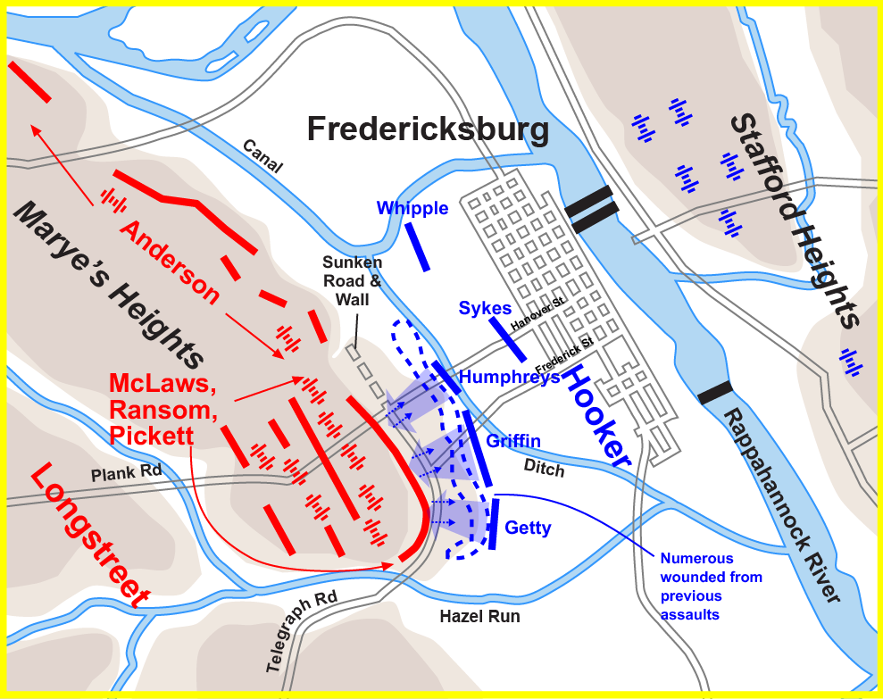
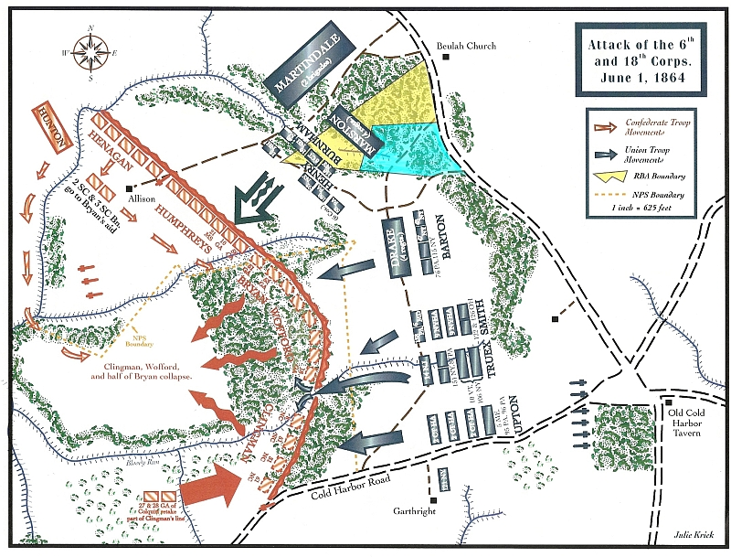
Fredericksburg 1862 Cold Harbor 1864
(12, 653 Union; 5300 CSA) (12,738 Union; 5287 CSA)

Slide 13
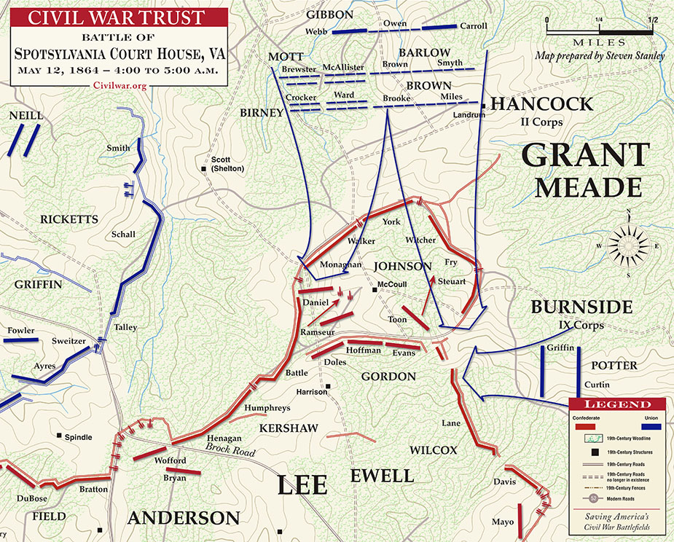
Spotsylvania 1864
(18,324/110,000 Union; 12,687/63,000 Confederate)

Slide 14
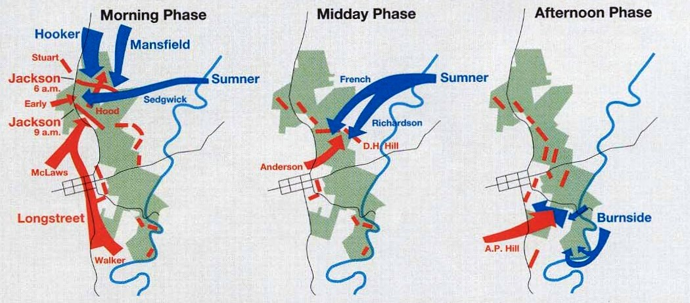
Antietam 1862
(12,410/87,164 Union; 10, 316/38,000 Confederate)

Slide 15
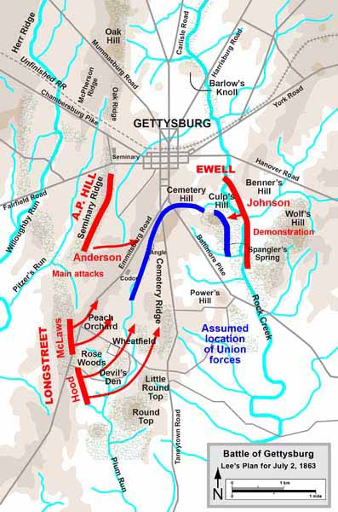
Gettysburg 1863: When the Enemy Adopts your Strategy
Out of his comfort zone: Lee on the Offensive

Slide 16
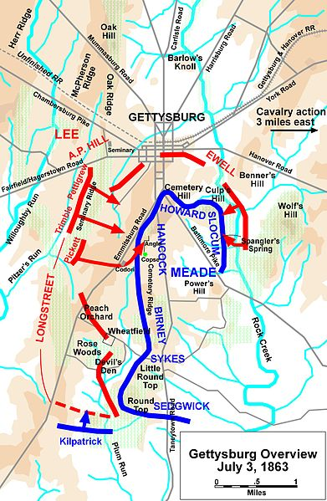
Meade Turns the Tables:
23,049/104,256 Union
28,156/79,000 CSA

Slide 17
THE LEDGER
POPULATION | ECONOMIC/ INDUSTRIAL CAPACITY | FOREIGN POLICY | STRATEGY | MOTIVATION/ ADVANTAGES +/-
19.6 million (+3.5 million border) | 22k RR miles 15.5k miles telegraph $3.6 billion GNP (83.2%) 110,000 factories | Isolationist Gov’t-sponsored protectionism Goals: Isolate Europe from war; prevent recognition of CSA | ANACONDA Blockade Divide CSA; seize Miss River A stake through the heart | Union Liberation (after 1863) Resources Government -------- Enlistment troubles; 1863 conscription
9.1 million (-3.8 million slave) | 8500 RR miles 1.4k miles telegraph $7.3 million GNP (16.7%) 1800 factories | Free trade No non-economic foreign policy Goals: British/ French recognition; USA trade | DEFENSIVE Offensive in nature; make use of mobility and maneuver Foreign recognition | Independence Leadership --------- Non-renewable manpower Conscription 1862 Government

Slide 18
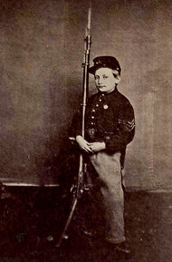
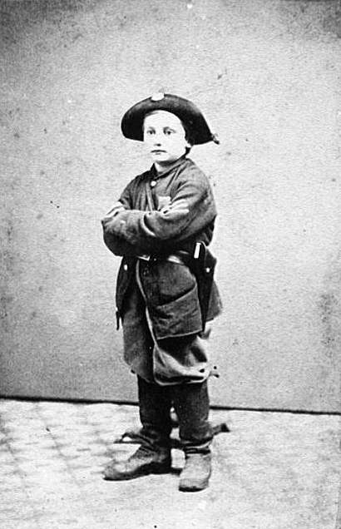
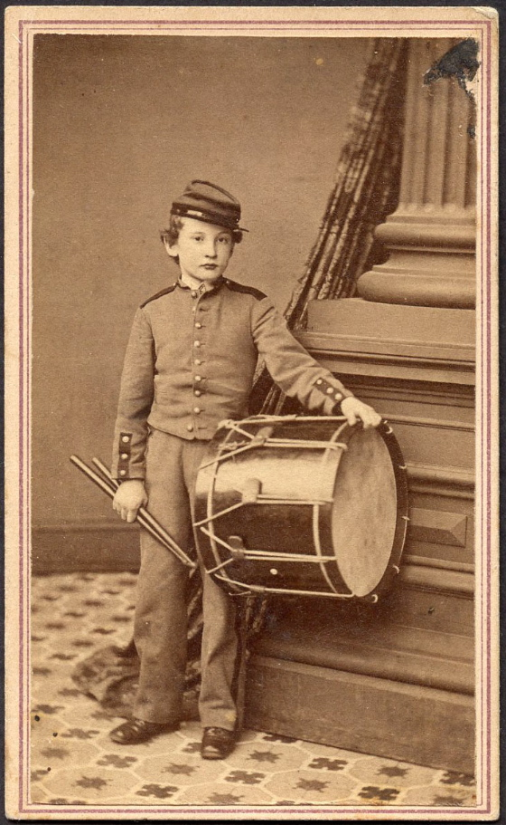
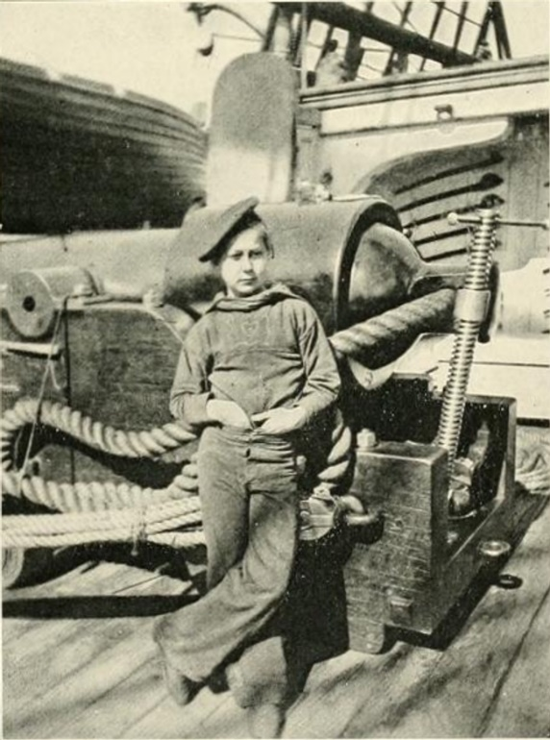
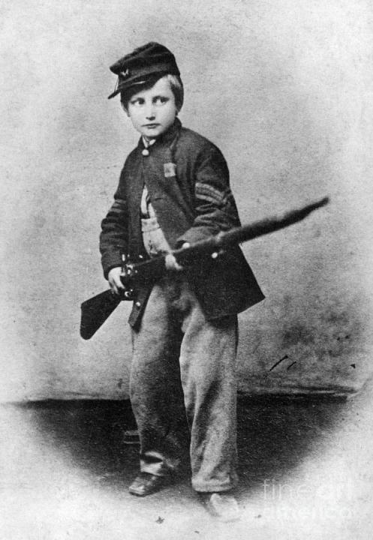

Slide 19
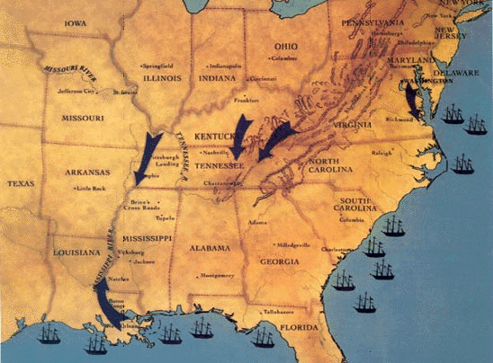
ANACONDA

Slide 20
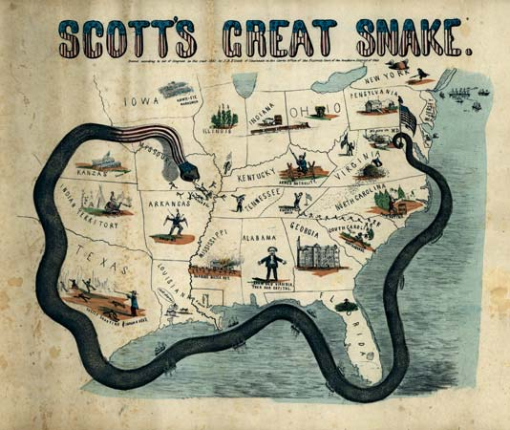

Slide 21
1861
July: 1st Manassas (Bull Run), CSA
August: Wilson’s Creek (Mo), Fremont’s Emancipation Edict, CSA
“ As to General Fremont’s order, I cannot agree with the confiscation of
personal property involving the liberation of slaves . . . this is entirely a
political move, void of Congressional approval, and not within the
range of any military law or necessity and therefore unconstitutional; as
Commander in Chief I hereby remand the proclamation.”
1862
The West (operations on the Mississippi)
Donaldson and Henry (January/February), Grant, USA
Shiloh (April), Grant, USA
St. Philip/St. Jackson; New Orleans Farragut, (April-May), USA
Island No. 10; Memphis (April), Porter, USA
The Peninsula (May-July); McClellan v Lee, CSA
The Valley (May-July); Jackson v Banks/McDowell, CSA

Slide 22
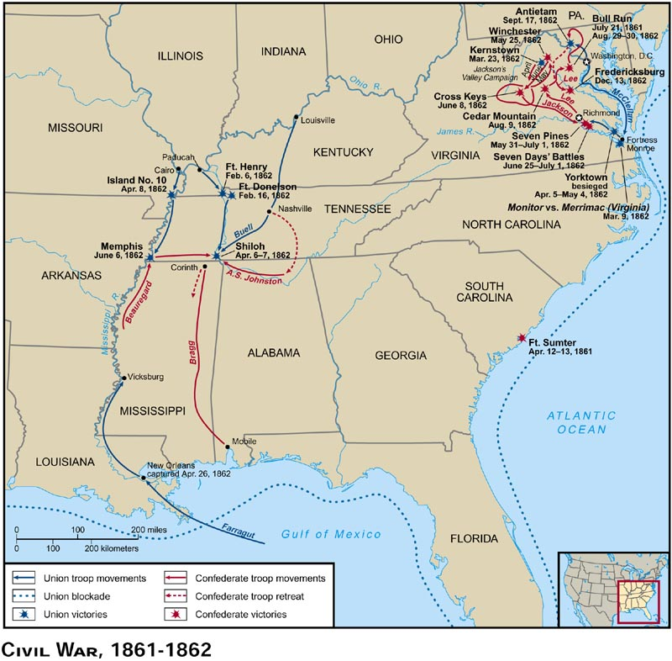

Slide 23
1862: Lincoln's Problems:
He’s losing.
Probable British/French Recognition
Trent Affair
Rise of the Copperheads
Public opinion turning, losing popular support
Dropping enlistments
Lincoln’s Solution: Emancipation
Increase domestic pressure on Britain and France
Change war aims from political to humanitarian by providing a cause
ORIGINALLY: Free Soiler agenda re slaves: emancipation, then colonization (Will Congress go along?)
Conscription Acts 1861,1862: Designate escaped slaves as contraband of war and thus eligible for Union protection/utilization.
Large Scale Emancipation? PROBLEM (Re Seward): Absent a military victory emancipation will appear desperation to Europe . . . Lincoln needs a win
Lee Takes the War North, Invades Maryland . . .WHY?
2nd Manassas (Bull Run), (Aug), Lee v Pope, CSA
Sharpsburg (Antietam), (Sept), Lee v McClellan, Inconclusive

Slide 24
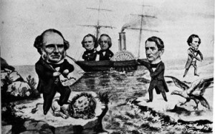
The Trent Affair

Slide 25
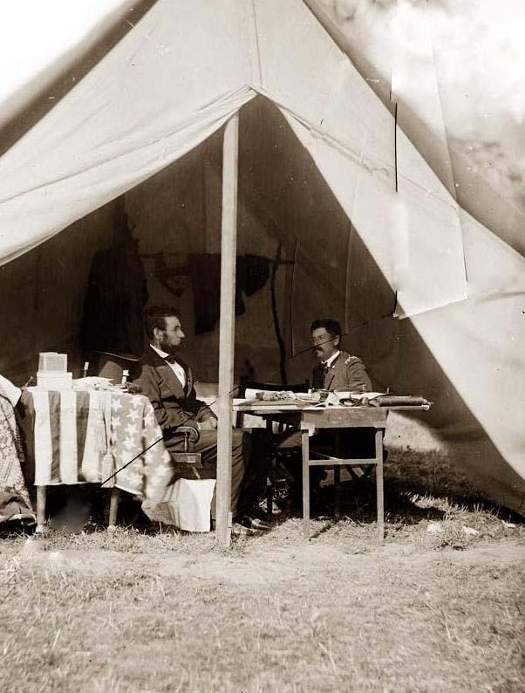
“General McClellan, if you are not going to use the army, may I borrow it?”
“BTW, you’re fired.”

Slide 26
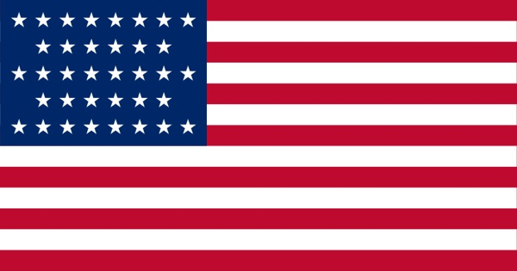
THE WARTIME ECONOMY
Quantitative vs. Qualitative

Slide 27
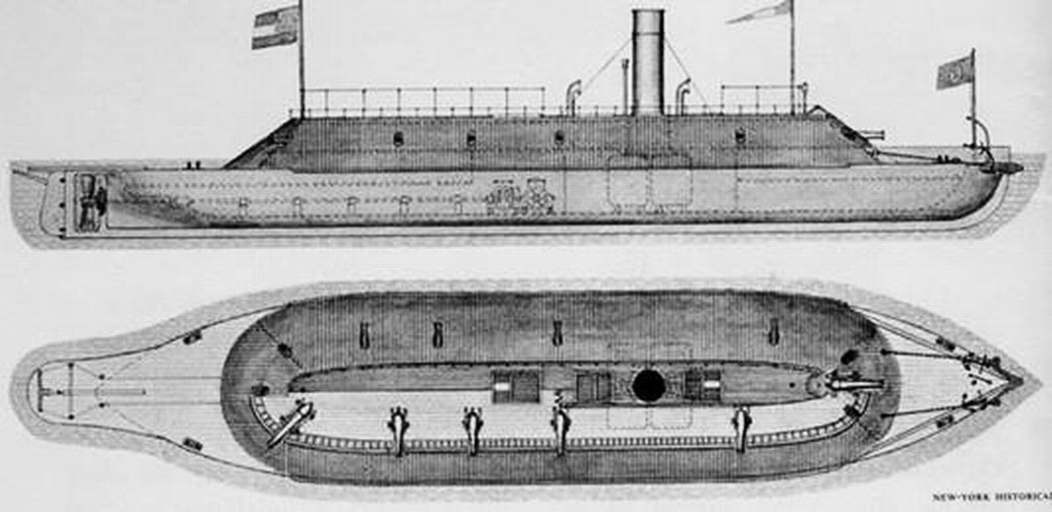
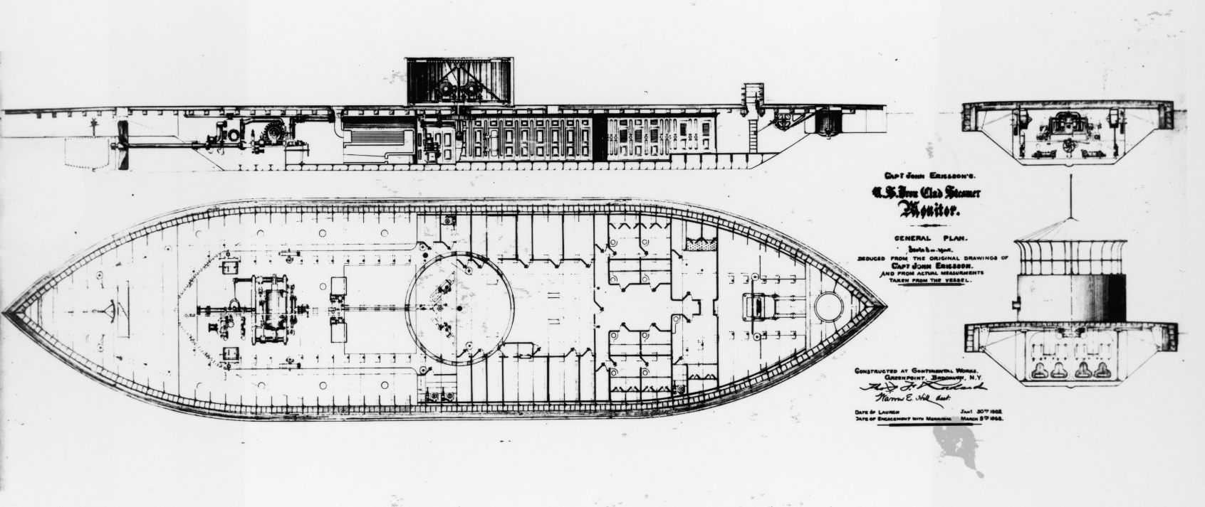
USS Monitor and CSS Virginia (Merrimac)

Slide 28
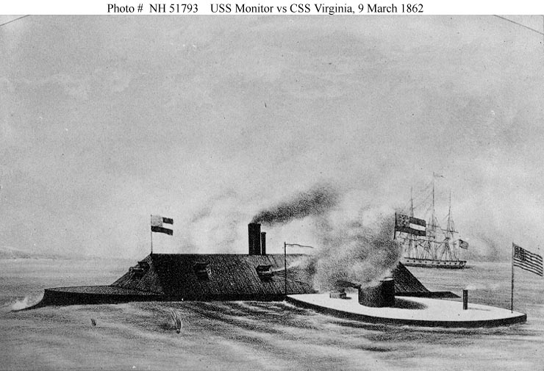
Southern Qualitative Economy: The Effects of Research and Development

Slide 29
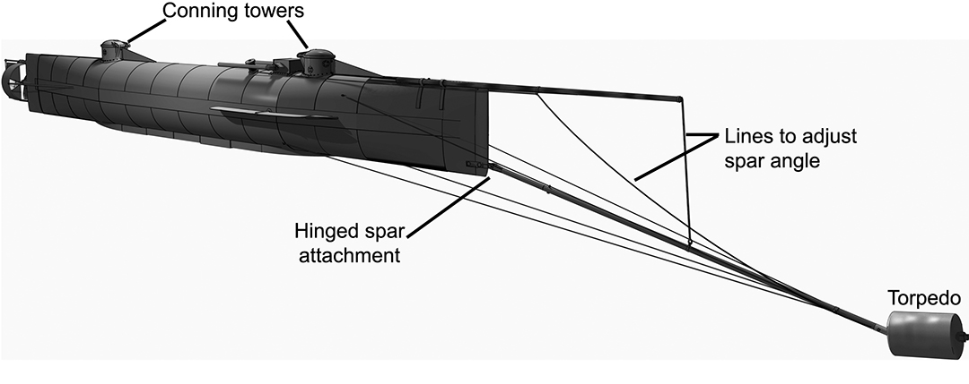
CSS Hunley

Slide 30
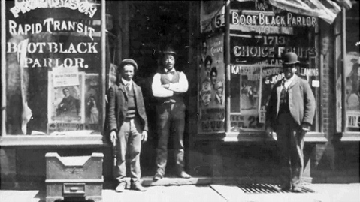
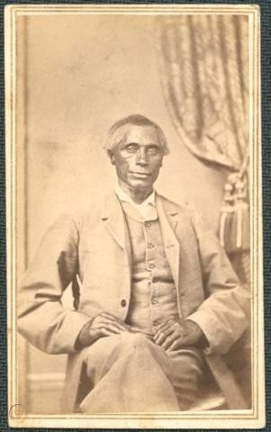
UNEXPLORED THEME: DEMOGRAPHIC OF BLACKS IN THE SOUTH DURING THE CIVIL WAR
Free Black Business in New Orleans, 1858
South Carolina
Slaveholder William
Ellison, 1860

Slide 31
“In the year of Lincoln’s election and Southern secession, there were a total of 488,070 free blacks living in the United States, about 10 percent of the entire black population. Of those, 226,152 lived in the North and 261,918 in the South, (Delaware, Kentucky, Maryland, Missouri, North Carolina, Tennessee, Virginia, Alabama, Arkansas, Florida, Georgia, Louisiana, Mississippi, South Carolina and Texas) plus the District of Columbia. Let me break that down further: A few months before the Confederacy was born, there were 35,766 more free black people living in the slave-owning South than in the North, and removing D.C. from the equation wouldn’t have shifted the result. And they stayed there during the Civil War. In addition significant number of these free blacks were the owners of slaves; the census of 1860 lists 3,775 free Negroes who owned a total of 12,760 slaves, the majority of whom lived in the Deep South.”
Henry Louis Gates, quoting Berlin Slaves Without Masters: The Free Negro in the Antebellum South, 1974; also 1860 Census Report

Slide 32
THE PRELIMINARY PROCLAMATION August 1862
“ On the first day of January in the year of our Lord, one thousand eight hundred and sixty-three, all persons held as slaves within any State, or designated part of a State, the people whereof shall then be in rebellion against the United States shall be then, thenceforward, and forever free; and that the effort to colonize persons of African descent, upon this continent, or elsewhere, with the previously obtained consent of the Governments existing there, will be continued . . .
[I also] will recommend that all citizens of the US who have remained loyal, upon the restoration of the constitutional relationship between the US and their respective States, be compensated for all losses, including the loss of slaves.”

Slide 33
Lincoln attempts to allay criticism to avert disaster in the 1862 midterms:
“I do not want to issue a document that the whole world will see as inoperative . . . it would as the Pope’s bull against the comet! Would my word alone free the slaves, when I cannot even enforce the Constitution in the rebel states? As slaves flock to our lines, what should we do with them? How are we to feed and clothe so many destitute people? Nor do I urge objections of a moral nature, in view of possible consequences of insurrection and massacre in the South. I view the matter as a practical war measure, to be decided upon according to the advantages or disadvantages it may offer to the suppression of the rebellion.”
Lincoln, Chicago Tribune, 23 September 1862

Slide 34
LINCOLN’S 2 DECEMBER 1862 MESSAGE TO CONGRESS
I hereby propose the following articles be remanded to the legislatures of the States as amendments to the Constitution of the United States:
ART. I: Every State wherein slavery now exists which shall abolish the same therein at any time before the 1st day of January, A. D. 1900, shall receive compensation from the United States.
ART. II: Congress may appropriate money and otherwise provide for colonizing free colored persons with their own consent at any place or places without the United States.

Slide 35
EUROPEAN CONFUSION RE THE 2 DECEMBER MESSAGE
“Evidently this threat [Emancipation Proclamation]--for it bears a menacing air—was intended to intimidate the British people to suppress their sympathy with the South and to influence her Majesty's Government; for a few days after this menace was received in London [Lincoln] practically revoked his Emancipation Proclamation, which had been uttered with so much personality a few weeks before; and, instead of abolishing slavery next week he offers to give the South the rest of the century to do it in, and to pay for it, too, if they will save him the trouble to have to do it himself.”
Palmerston to House of Commons,
Response to Lincoln’s 2 December Message to Congress,1862

Slide 36
The Final Draft: 1 January 1863
“Now, therefore I, Abraham Lincoln, President of the United States, by virtue of the power in me vested as Commander-in-Chief, of the Army and Navy of the United States in time of actual armed rebellion against the authority and government of the United States, and as a fit and necessary war measure for suppressing said rebellion, do, on this first day of January, in the year of our Lord one thousand eight hundred and sixty-three, designate as the States and parts of States wherein the people are this day in rebellion against the United States, the following:
Arkansas, Texas, Louisiana, (except the Parishes of St. Bernard, Plaquemines, Jefferson, St. John, St. Charles, St. James Ascension, Assumption, Terrebonne, Lafourche, St. Mary, St. Martin, and Orleans, including the City of New Orleans) Mississippi, Alabama, Florida, Georgia, South Carolina, North Carolina, and Virginia, (except the forty-eight counties designated as West Virginia, of which excepted parts, are for the present, left precisely as if this proclamation were not issued.)
And by virtue of the power, and for the purpose aforesaid, I do order and declare that all persons held as slaves within said designated States, and parts of States, are, and henceforward shall be free . . . I further declare and make known, that such persons shall be received into the armed service of the United States to garrison forts, positions, stations, and other places, and to man vessels of all sorts in said service.”

Slide 37
“You say ‘His Emancipation Proclamation has freed the slaves! That proves he was against slavery, an abolitionist!’ The proclamation has no legal justification, except as a military measure. Understand, I raise no objections against it [slavery] on legal or constitutional grounds ... I view the matter [emancipation] as a practical war measure, to be decided upon according to the advantages or disadvantages it may offer to the suppression of the rebellion."
Lincoln to Attorney General Edward Bates 1862
“The measure has the double advantage of taking labor away from the insurgent cause, and supplying those places in our army which otherwise must be filled by white soldiers.”
Lincoln to Congress, December 1862
“I think at least 100,000 colored troops can be raised relieving all the white troops. Every colored soldier who stops a bullet saves a white man’s life.”
Lincoln to Grant, August 1862
“Whenever Negros can be got as soldiers leaves just so much less for white soldiers to do.”
Lincoln to Senator James C. Conklin (R-NY), August 1862
“No human power can subdue this rebellion without using the emancipation lever as I have done. Emancipation has given us control of 200,000 able-bodied men, born and raised on Southern soil.”
Lincoln to Cabinet, March 1863

Slide 38
EFFECTS OF THE “WAR MEASURE:”
Of all white Union troops: 15% mortality rate
Of all black Union troops: 38% mortality rate
Emancipated troops used to shame free blacks in the North; boosted enlistment of non-emancipated blacks
“Once let the black man get upon his person the brass letter, U.S., let him get an eagle on his button, and a musket on his shoulder and bullets in his pocket, there is no power on earth that can deny that he has earned the right to citizenship.”
Frederick Douglass, 1863

Slide 39
Criticism:
“Never should a [commander] use such a demon as [racial] unrest as a military weapon. I cannot fight for such an accursed doctrine as that of a servile insurrection.”
George McClellan, January 1863
“We are preparing . . . [the proclamation] will have the effect of organizing and arming the colored population throughout the South to exact a terrible retribution.”
General Nathanial Banks, CO,
Department of the Mississippi, New Orleans, 1863
“We show our sympathy with slavery by emancipating slaves where we cannot reach them and holding them in bondage where we can set them free . . . This move will injure our standing in Europe . . . The one and only interest Britain and France have in our contest was a material one; the insurgents are only important as a source of cotton. There are no other principles involved, anything that increases the supply of this essential material would receive [European] approval; anything that diminished it would arouse their hostility. In the President’s view emancipation would help fill out armies, and that is a good thing. However, the extent to which it would handicap Southern agriculture would manifest itself in the hatred of the British governing, financial, and commercial classes by depriving their spindles of cotton.”
Seward to Salmon Chase, January 1863

Slide 40
The Proclamation as Foreign Policy?
“Are the enlightened and humane nations Great Britain and France to throw their protection over the insurgents now? Are they willing to enter this conflict that has become a war between freedom and bondage?”
Lincoln to Seward, Oct 1862
“No other step [emancipation] would be so potent to prevent European intervention . . . what the rebels most fear is what we should be most desire to do, and what they most fear is evident from the haste with which, on the first day of the present session of the rebel Congress, bills were introduced threatening terrible vengeance if we used blacks in the war.”
Lincoln,
Speech to Chicago Christians of All Denominations, September 1862

Slide 41
“ Europe regards the war as proof that democratic institutions cannot work and therefore they rejoice in our difficulties. Most believe that slavery caused the war and thus concluded that the destruction of slavery was to be the policy of our government, despite Mr. Lincoln’s protestations to the contrary. The Proclamation has had the effect of appearing that we have no avowed policy, and thus perplexed Europeans and generated little sympathy for its cause. Europeans will intervene to prevent the abolition of slavery for the sake of cotton.”
Seward, Memorandum to Senator Charles Sumner, April 1863.
“This decree is an irrational clamor for making emancipation, rather than reunion, the object of the war. It may eventually put an end to extensive slave labor, which will cripple cotton production in the Confederacy; this will undoubtedly please Mr. Lincoln. But there is equal propensity that this result will be accompanied by a Negro insurrection, either of which are plausible excuses for intervention.”
Seward to Adams, March 1863

Slide 42
Back to the War
1863: The Momentum Shifts
Lee Invades the North . . . Again
Gettysburg (July 1-3), Lee v Meade, USA
The “High Water Mark” of the Confederacy; the Turning Point
Grant Seizes the River
Fall of Vicksburg (May), Grant v Pemberton, USA
Phase II of Anaconda complete
Driving the Stake
Chickamauga (September), Rosencrans USA v Bragg CSA, CSA
Chattanooga (November), Grant v Bragg, USA
Fall of Atlanta (Nov), Sherman v Johnston, USA
Beginning of the March to the Sea

Slide 43
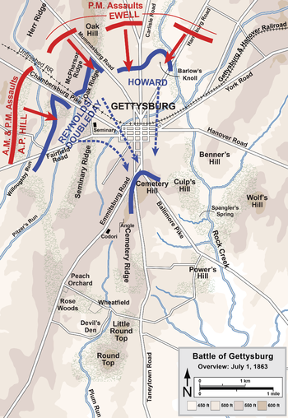
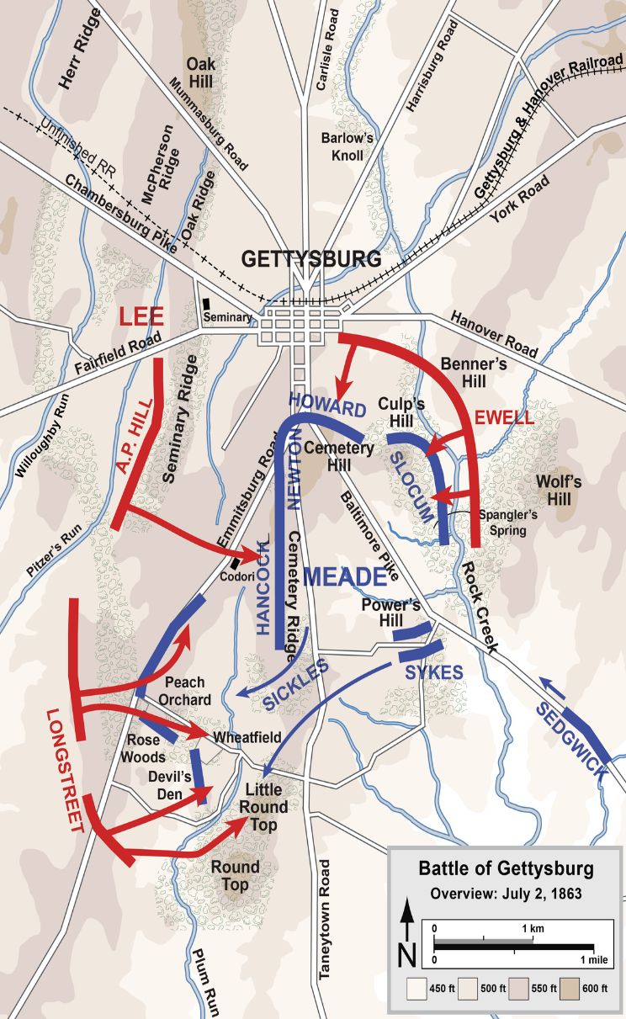
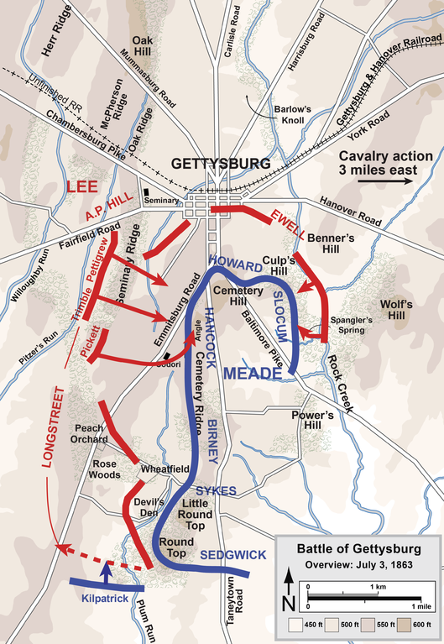
THE TURNING POINT: GETTYSBURG
THE HIGH WATER MARK OF THE CONFEDERACY

Slide 45
Summer 1863: The New War
Post-Gettysburg/Vicksburg, Lincoln redefines the war as a dichotomy of purpose:
“Fourscore and seven years ago our fathers brought forth, on this continent, a new nation, conceived in liberty, and dedicated to the proposition that all men are created equal. Now we are engaged in a great civil war, testing whether that nation, or any nation so conceived, and so dedicated, can long endure.
It is for us the living, rather, to be dedicated here to the unfinished work which they who fought here have thus far so nobly advanced. It is rather for us to be here dedicated to the great task remaining before us—that from these honored dead we take increased devotion to that cause for which they here gave the last full measure of devotion—that we here highly resolve that these dead shall not have died in vain—that this nation, under God, shall have a new birth of freedom, and that government of the people, by the people, for the people, shall not perish from the earth."
Abraham Lincoln, Gettysburg Address, 1863

Slide 46
8 Dec 1863
After Chickamauga/ Chattanooga /Atlanta:
Lincoln’s Proclamation of Amnesty and Reconstruction
(The 10% Plan, or Presidential Reconstruction)
CSA states can be readmitted when following conditions are met:
10% of white male population swears allegiance to the US
Constitution
Citizens will be pardoned (EXCEPT for former CSA officials)
State must accept emancipation laws
Lincoln’s Plan:
Economic base (motivation)
Non-Punitive
Colonization remains unstated option

Slide 47
Not a Bad Deal, So What’s the Problem? (and There IS a BIG Problem)
Constitutional:
What?
How?
Who?
Political:
Who has what to gain?
Free Soilers: What have you done for me lately, Abe?
Democrats (Copperheads): Reality check re their future.
Radical Republicans (Dominant Party): Oh HELL no!
The Radical Challenge to Lincoln: The Wade-Davis Bill (1864)
Majority of white male citizens must swear allegiance
States must submit state constitutions for Congressional approval
“Ironclad Oath” that they had REMAINED loyal to be eligible for public service
State must abolish slavery
States must pay off their war debts

Slide 48
WRAP YOUR MIND AROUND RECON
The Constitution: Issues
Secession/Readmission
Executive/legislative responsibility
How far can loose interpretation go?
Motivation:
Lincoln:
Radicals:
Southerners (cavalier-planter class):
Slaves/Freedmen
Status?
Lincoln/emancipation vs Radicals/abolition
Freedmen’s Bureau

Slide 49
ADIOS, ABE . . . HELLO ANDY
The Lincoln Assassination
Booth:
Effects
Racial
Political
Andrew Johnson
Why was a former Tennessee Jacksonian Democrat slave-holder Abe’s doing on Lincoln’s 1864 ticket?
Johnson’s version of Presidential Recon . . . Notice the target
Be sure you are familiar with ALL THREE Recon plans
Similarities
Differences
Potential consequences

Slide 50
THE SOUTH DURING RECONSTRUCTION
Social, political, economic devastation
Exploding the Pyramid: Economic destruction=political destruction
Cavalier/Planter/Fire Eaters
Yeoman farmers
Poor yeomen (“white trash”)
Blacks
Immediate reaction: Back to the Future
Home Rule
What is it?
Under which Recon plan could it establish itself?
What is the greatest threat to its emergence?
Black Codes
The Legacy of the “Great Man”

